Slide 1
Kinetic energy

Slide 2
Kinetic
Energy
Speed
Velocity
Joules
Mass
Kilogram
State the types of object that have kinetic energy.
Recall the equation for kinetic.
Calculate kinetic energies using the equation.

Slide 3
Kinetic energy
Any object that is moving has kinetic energy. The greater the mass or velocity of the object, the greater the amount of kinetic energy.
Stretch: A football is kicked vertically up in the air. List the changes in energy stores as the ball goes up & then back down.

Slide 4
Equation for kinetic energy
E_{k} = ½ x m x v²
Where E_{k} is the kinetic energy in joules (J)
m is the mass in kilograms (kg)
v is the velocity in metres per second (m/s)
Stretch: Rearrange the equation to give equations for mass and velocity.

Slide 5
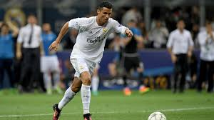
Rearranged equations
E_{k} = 0.5 x m x v²
Stretch: Answer question below
Cristiano Ronaldo kicks a ball of mass 0.5kg at a velocity of 20 m/s. What is the kinetic energy of the football?
$$m=\frac{E_{k}}{\text{0.5} \text{x} \text{v}\text{²}}$$
v $=\sqrt{\frac{E_{k}}{\text{0.5} \text{x} m}}$

Slide 6
Stretch Review
Cristiano Ronaldo kicks a ball of mass 0.5kg at a velocity of 20 m/s. What is the kinetic energy of the football?
STEP 1 - Write down equation
E_{k} = 0.5 x m x v²
STEP 2 - Write down variables
m = 0.5 kg, v = 20 m/s
STEP 3 – Put variables into equation and calculate answer. REMEMBER UNITS!
E_{k} = 0.5 x 0.5 x 20² = 0.5 x 0.5 x 400 = 0.5 x 200
= 100 Joules
Super stretch: Usain Bolt runs at a velocity of 10 m/s, and has a mass of 80 kg. What is his kinetic energy?

Slide 7
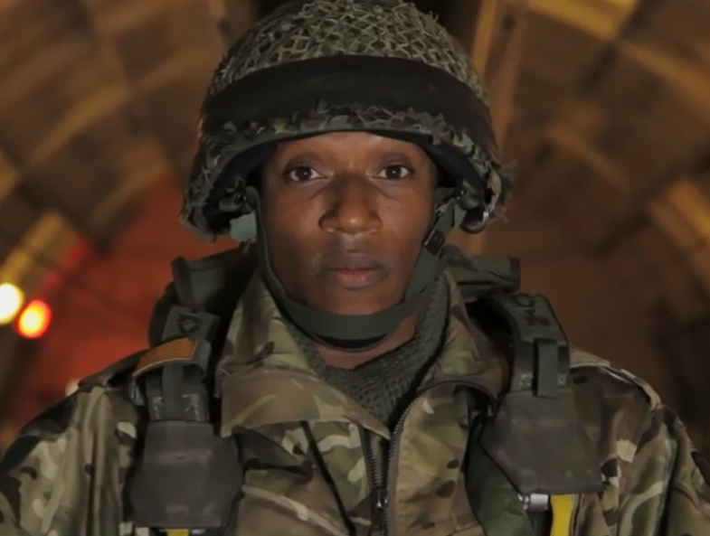
Task
Body armour is designed to resist penetration by projectiles.
The more kinetic energy that a projectile has, the greater its penetration.
British army issue body armour requires a minimum of 1,500 J of kinetic energy to penetrate it.
Your task is to find out which of a selection of different weapons would be a risk to penetrate the armour.
Bronze | Silver | Gold
1 or less out of 3 | 2 out of 3 | 3 out of 3

Slide 8
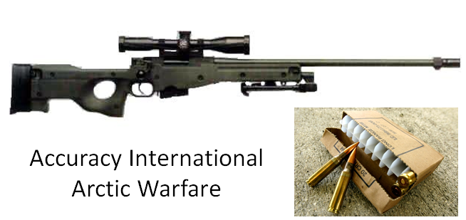
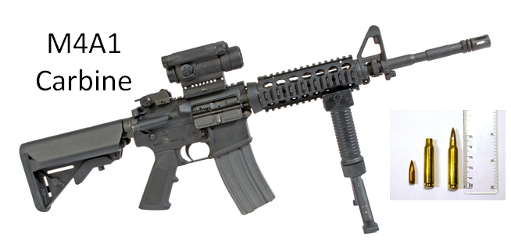
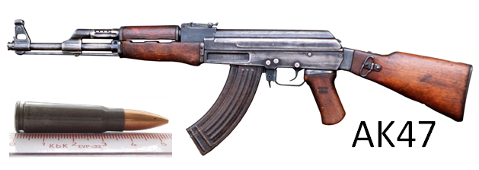
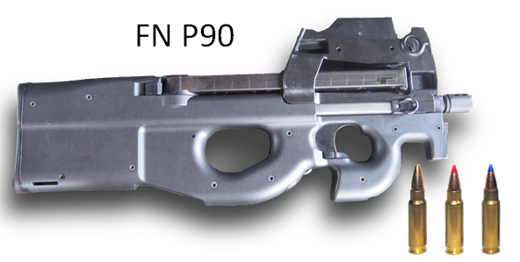
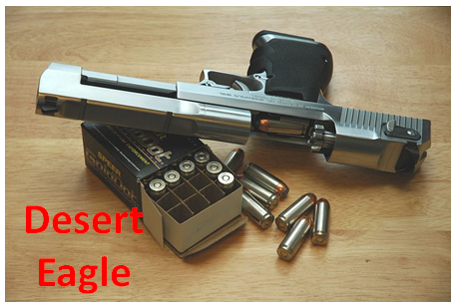
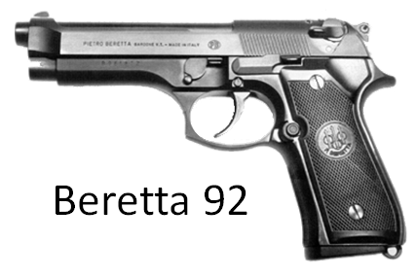

Slide 9
Gun type | Round type | Round mass (g) | Muzzle velocity (m/s) | Kinetic Energy (J)
M4A1 Carbine | 5.56×45mm NATO | 0.0041 | 800 | 1312
Desert Eagle | .50 Action Express | 0.02 | 430 | 1951
Arctic Warfare | 7.62×51mm NATO | 0.0113 | 800 | 3616
AK47 | 7.62×39mm | 0.008 | 641 | 1644
Beretta 92 | .40 S&W | 0.0107 | 350 | 658
FN P90 | FN 5.7x28mm | 0.002 | 716 | 513

Slide 10
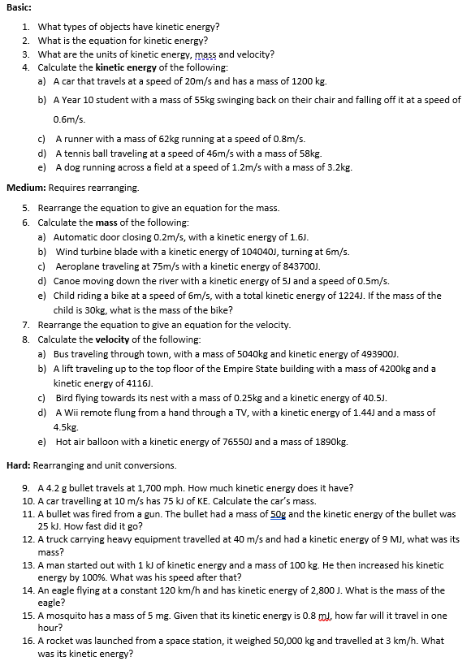
Worksheet
Complete the worksheet!

Slide 11
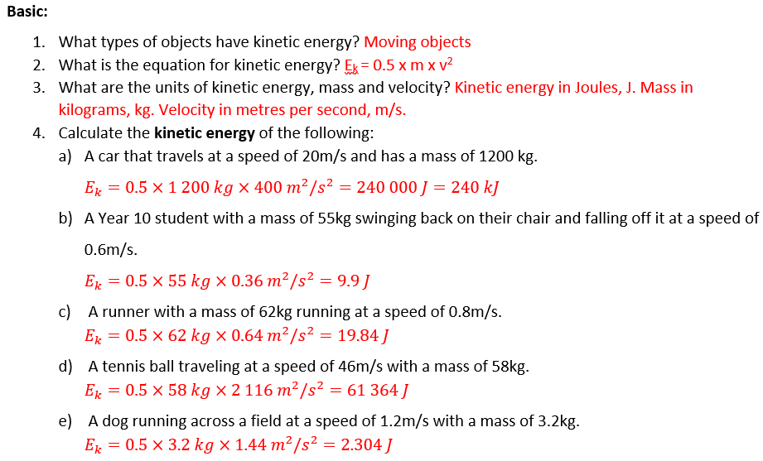

Basic answers

Slide 12
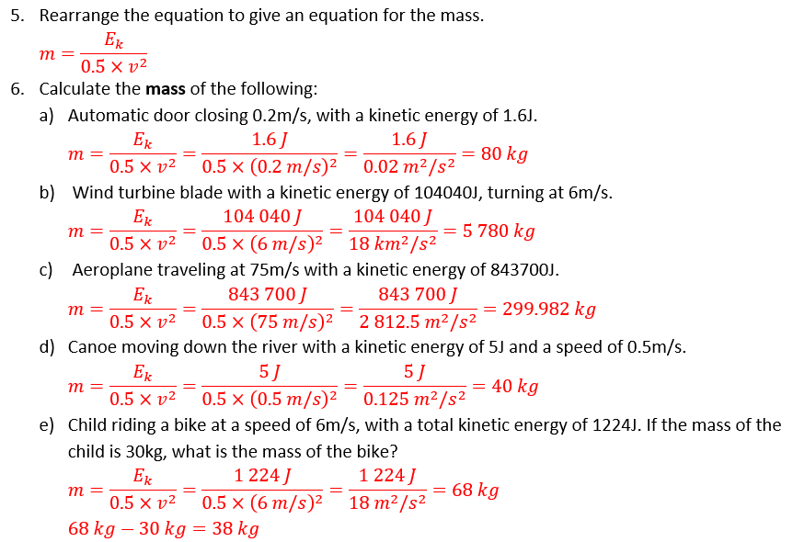
Medium answers

Slide 13
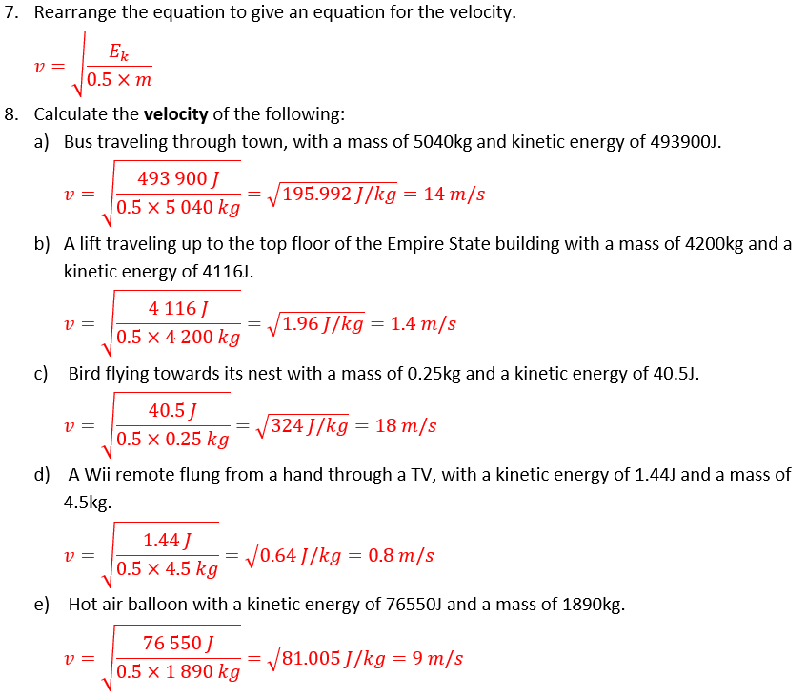
Medium answers

Slide 14
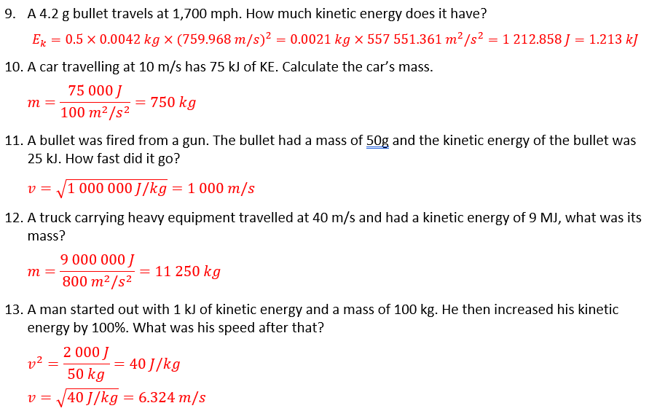
Hard answers

Slide 15
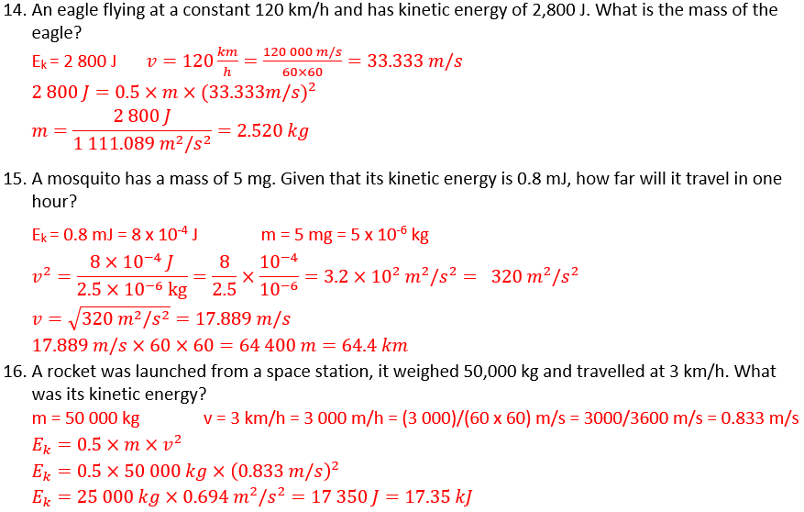
Hard answers

Slide 16
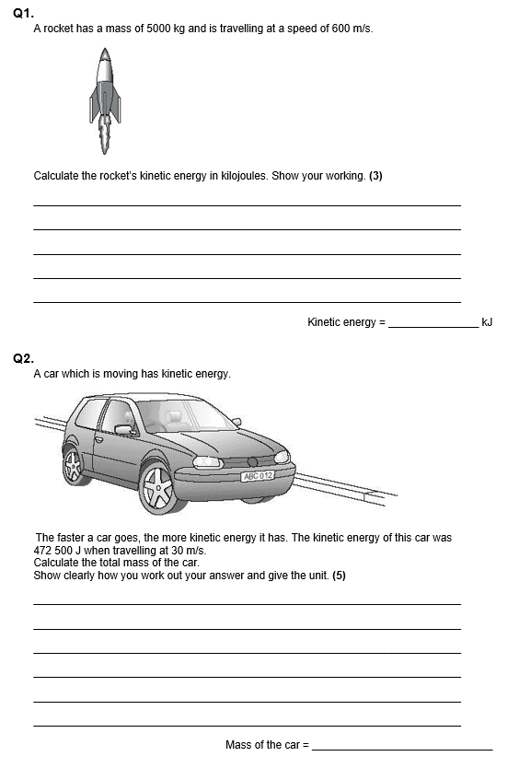
Struggle time
Exam questions so exam conditions!
You have 8 minutes.

Slide 17
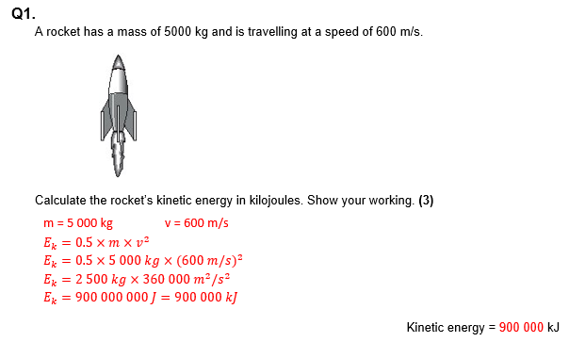
Struggle time review

Slide 18
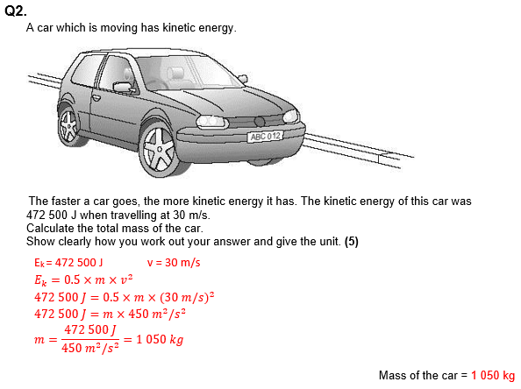
Struggle time review

Slide 19
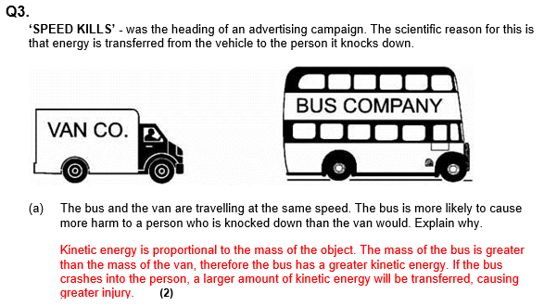

Slide 20
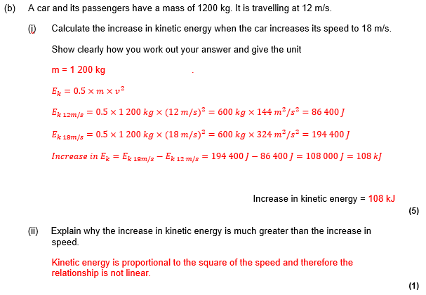
Struggle time review

