Slide 1
Pressure in gases
30/10/2020

Slide 2
Pressure in gases
Gas
Particle
Velocity
Kinetic
Pressure
Force
Area
Recall what happens to a gas as it’s heated.
Recall what causes pressure.
Predict what will happen to the pressure inside an object under difference circumstances.

Slide 3
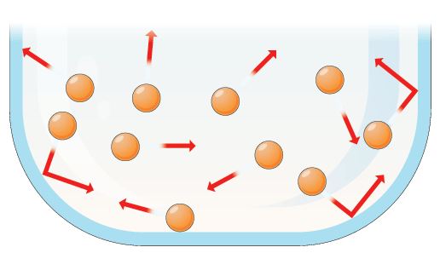
T/N: Gas particles move randomly in all directions at different speeds. As a gas heats, it gains energy and the speed of the particles increases.
Stretch: A particle has a mass of 0.002 kg and a velocity of 100 m/s. Calculate the kinetic energy of the particle.

Slide 4
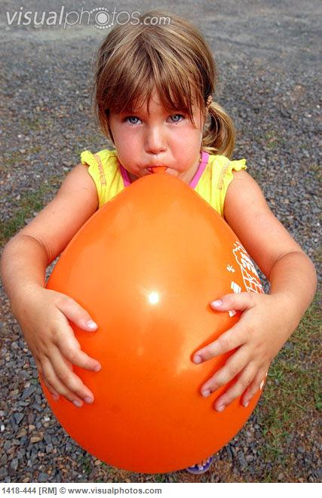

T/N: Pressure is a result of particles colliding with a surface.
The more particles the more pressure.
Pressure has units of pascals (Pa).
Stretch:
The reason balloons get bigger when you blow them us is because more air means more _________. More particles means more ________. More collisions means higher ______

Slide 5

Pressure & temperature
WHAT HAPPENS TO AN INFLATED BALLOON IF WE PUT IT INTO LIQUID NITROGEN.
EXPLAIN YOUR ANSWER.

Slide 6
Video
https://www.youtube.com/watch?v=9vRMZSEF_a4&ab_channel=CrazyRussianHacker

Slide 7
What happens to the pressure if we put the same amount of particles in a smaller container?

Slide 8


Which of these is under greater pressure?
B

Slide 9
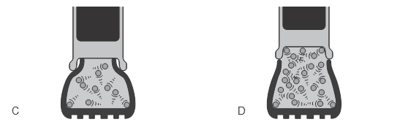
Which of these is under greater pressure?
D

Slide 10
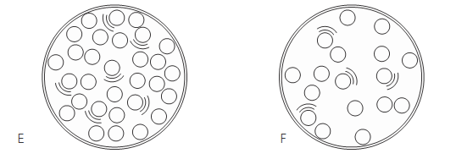
Which of these is under greater pressure?
E

Slide 11
When gas particles bump into something…
A …they cause pressure
B …they cause density
A

Slide 12
Pressure is increased…
A …when less particles hit the side
B …when more particles hit the side
B

Slide 13
When you blow up a balloon, it gets bigger because…
A …pressure increases inside
B …pressure decreases inside
A

Slide 14
Worksheet
Complete the worksheet.

Slide 15

Worksheet answers
Gas molecules hitting the walls of the container.
True. The temperature of the air particles will be higher and therefore moving more quickly. This means the particles hit the walls of the balloon more often and the pressure will therefore be higher.
Pressure will increase as the particles will hit the walls more often.
Flask 1 because it has a smaller volume and particles will hit the walls more often.

Slide 16
Worksheet answers
5. By reducing the volume of the container. Particles will hit the walls more often.
6. Because the temperature of the air in the tyres will increase. This increases the speed of the air particles and they will hit the walls of the tyres more often (increasing the pressure).
7. Flask 1 because it’s at the lowest temperature, particles move more slowly and hits the sides of the flask less often.
8. Flask 4 because the pressure is the highest. Particles will hit sides of flask more often.
9. The pressure will increase as the gas gets hotter (because the particles are moving more quickly). This pressure will then open the valve.

Slide 17
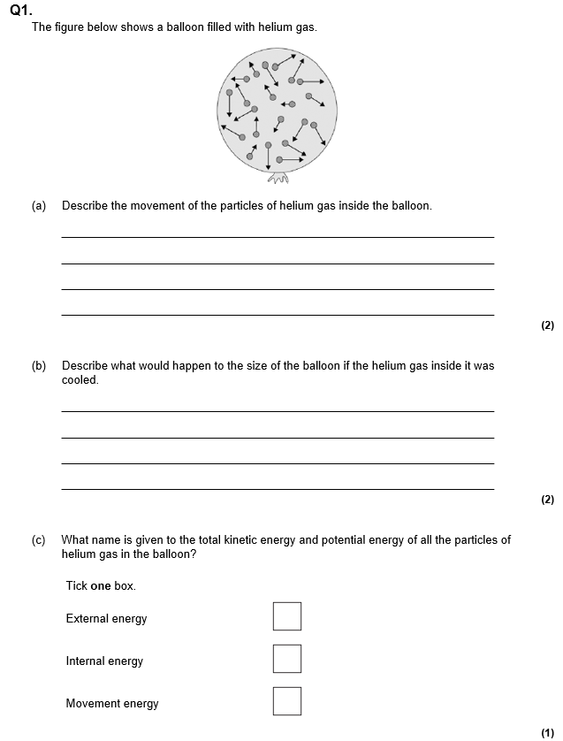
Struggle time!
Exam question so exam conditions!
You have 8 minutes!

Slide 18
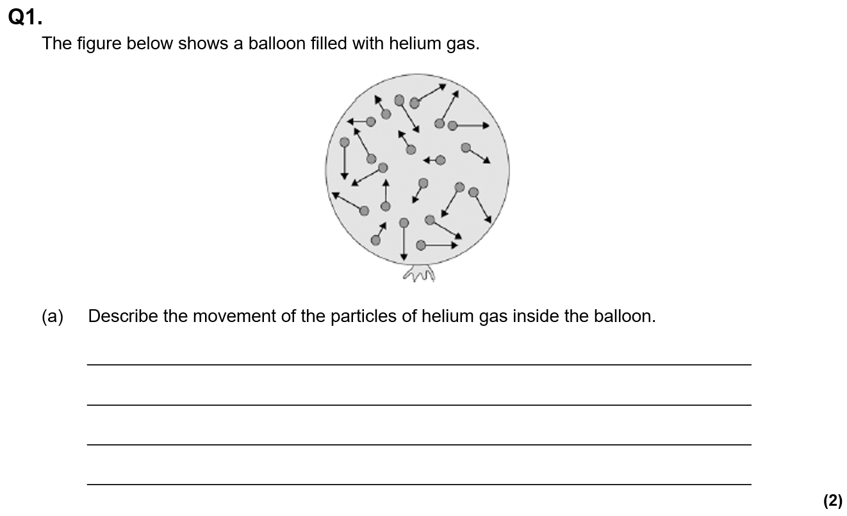
Struggle time review

Slide 19
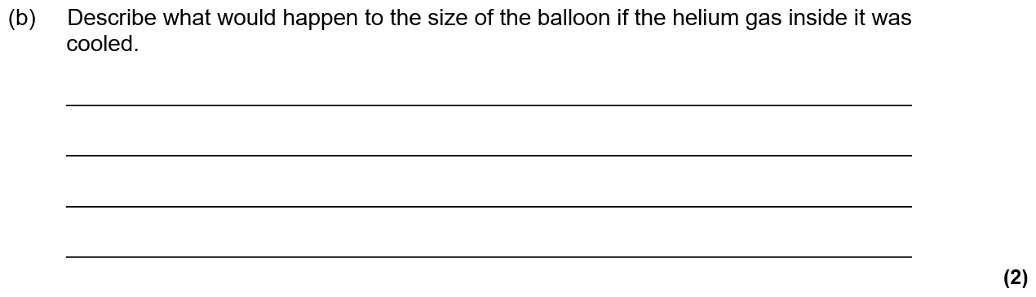
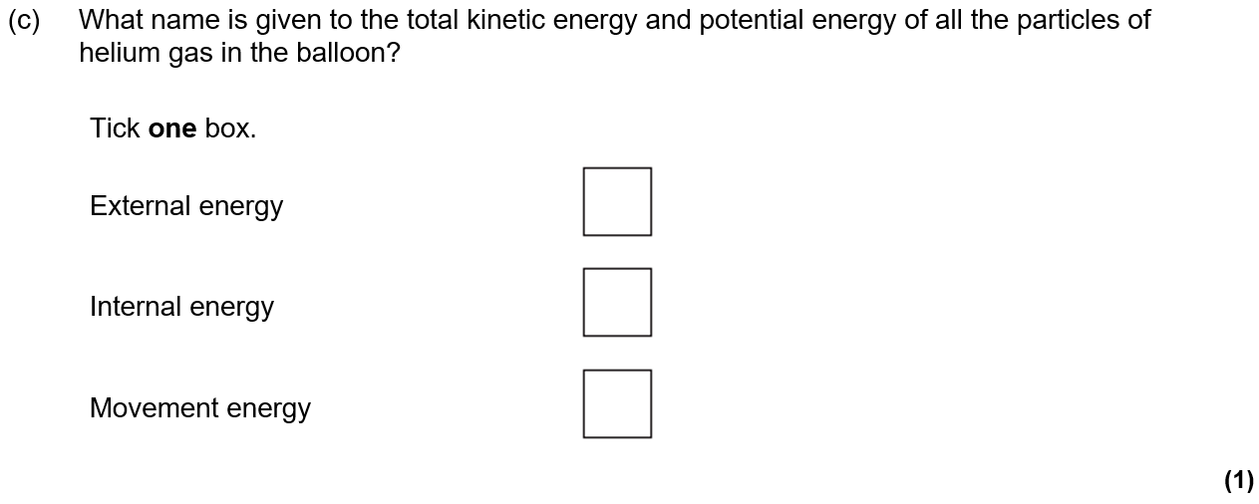

Slide 20
