Slide 1
Specific heat capacity
30/10/2020
Sketch the cooling curve of stearic acid.
Why doesn’t the temperature change while the stearic acid is freezing?

Slide 2
Specific heat capacity
Energy
Joule
Mass
Kilogram
Temperature
Specific heat
Recall the definition of specific heat capacity.
Recall the equation ΔQ = m × c × ΔT
Calculate energy transfers, mass & specific heat capacities using the equation.

Slide 3



Specific heat capacity
SAME amount of HEAT ENERGY
Small TEMPERATURE RISE
Large TEMPERATURE RISE
WATER
SAND
Putting the SAME AMOUNT OF HEAT into some materials gives a BIGGER TEMPERATURE RISE than in other materials

Slide 4
Specific heat capacity
The specific heat capacity (c) is the amount of energy needed to increase the temperature of 1 kg of a substance by 1 °C.
Stretch
If something has a high specific heat capacity does it take a longer or shorter time to heat up? Why?

Slide 5
Specific heat capacity
Energy can be calculated using the following:
ΔE = m x c x Δθ
Where:
ΔE = change in thermal energy (J)
m = mass (kg)
c = specific heat capacity (J/kg°C)
Δθ = change in temperature (°C)
Stretch
Re-arrange the equation to give equations for m, c and ΔT.

Slide 6
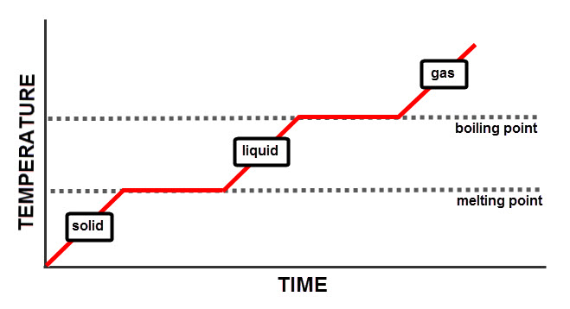

Slide 7
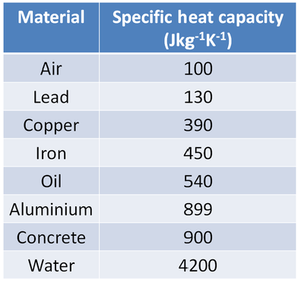
Modelled example
Calculate the energy needed to increase the temperature of 500 g of water by 10˚C.

Slide 8
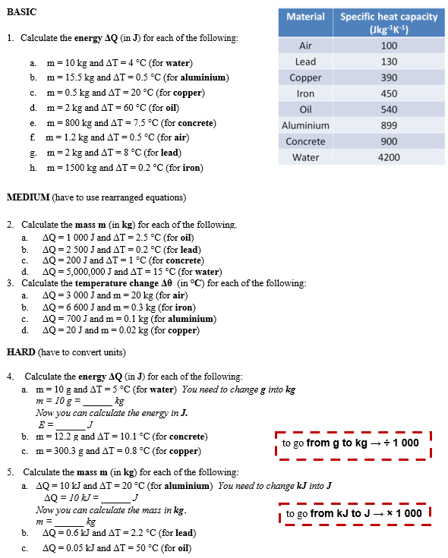
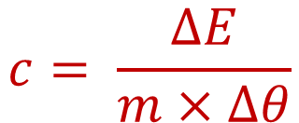
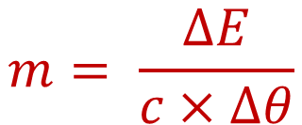
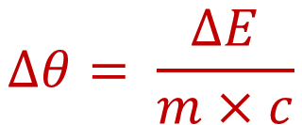
Worksheet
Complete the worksheet.
$$m= \frac{∆E}{c×∆θ}$$
$$c= \frac{∆E}{m×∆θ}$$
$$∆θ= \frac{∆E}{m×c}$$

Slide 9

Basic answers
1. a) ΔE = m x c x Δθ = 10 x 4200 x 4 = 168,000 J
b) ΔE = m x c x Δθ = 15.5 x 899 x 0.5 = 6,967 J
c) ΔE = m x c x Δθ = 0.5 x 390 x 20 = 3,900 J
d) ΔE = m x c x Δθ = 2 x 540 x 60 = 64,800 J
e) ΔE = m x c x Δθ = 800 x 900 x 7.5 = 5,400,000 J
f) ΔE = m x c x Δθ = 1.2 x 100 x 0.5 = 60 J
g) ΔE = m x c x Δθ = 2 x 130 x 8 = 2,080 J
h) ΔE = m x c x Δθ = 1500 x 450 x 0.2 = 135,000 J

Slide 10
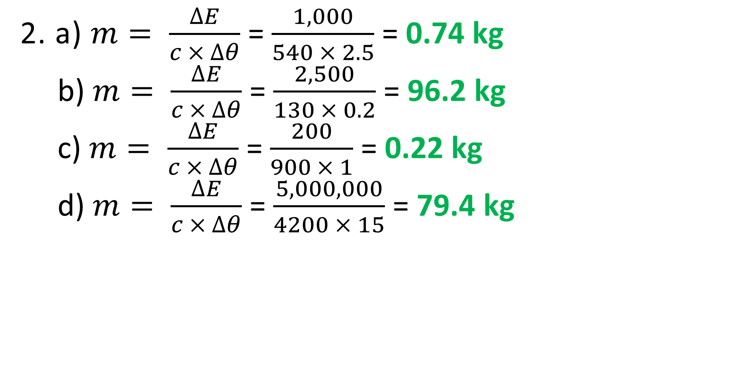
Medium answers
2. a) $m= \frac{∆E}{c × ∆θ}$ = $\frac{1,000}{540 × 2.5}$ = 0.74 kg
b) $m= \frac{∆E}{c × ∆θ}$ = $\frac{2,500}{130 × 0.2}$ = 96.2 kg
c) $m= \frac{∆E}{c × ∆θ}$ = $\frac{200}{900 × 1}$ = 0.22 kg
d) $m= \frac{∆E}{c × ∆θ}$ = $\frac{5,000,000}{4200 × 15}$ = 79.4 kg

Slide 11
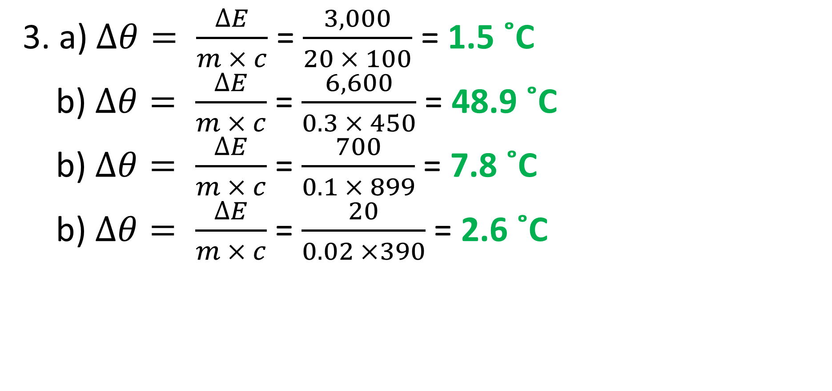
Medium answers
3. a)$∆θ= \frac{∆E}{m × c}$ = $\frac{3,000}{20 × 100}$ = 1.5 ˚C
b) $∆θ= \frac{∆E}{m × c}$ = $\frac{6,600}{0.3 × 450}$ = 48.9 ˚C
b) $∆θ= \frac{∆E}{m × c}$ = $\frac{700}{0.1 × 899}$ = 7.8 ˚C
b) $∆θ= \frac{∆E}{m × c}$ = $\frac{20}{0.02 ×390}$ = 2.6 ˚C

Slide 12
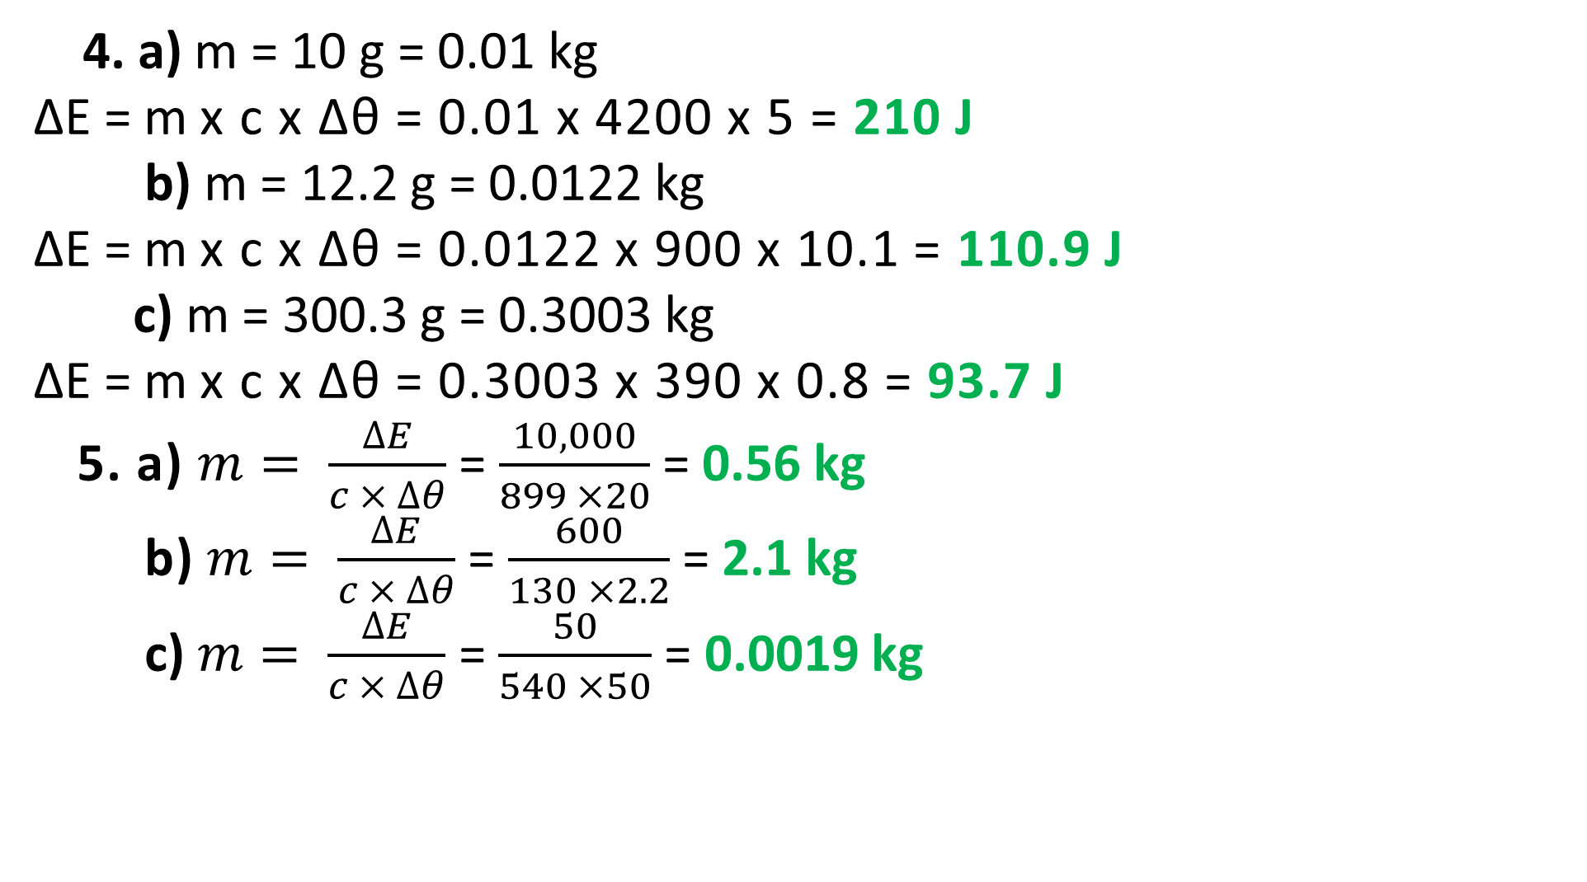
Hard answers
  4. a) m = 10 g = 0.01 kg
ΔE = m x c x Δθ = 0.01 x 4200 x 5 = 210 J
b) m = 12.2 g = 0.0122 kg
ΔE = m x c x Δθ = 0.0122 x 900 x 10.1 = 110.9 J
c) m = 300.3 g = 0.3003 kg
ΔE = m x c x Δθ = 0.3003 x 390 x 0.8 = 93.7 J
5. a) $m= \frac{∆E}{c × ∆θ}$ = $\frac{10,000}{899 ×20}$ = 0.56 kg
b) $m= \frac{∆E}{c × ∆θ}$ = $\frac{600}{130 ×2.2}$ = 2.1 kg
c) $m= \frac{∆E}{c × ∆θ}$ = $\frac{50}{540 ×50}$ = 0.0019 kg

Slide 13
Struggle time!
Exam question so exam conditions!
You have 6 minutes!

Slide 14
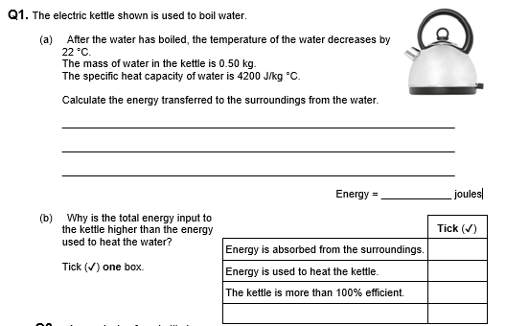
Struggle time review
ΔE = m x c x Δθ = 0.5 x 4200 x 22 = 46,200 J
✓

Slide 15
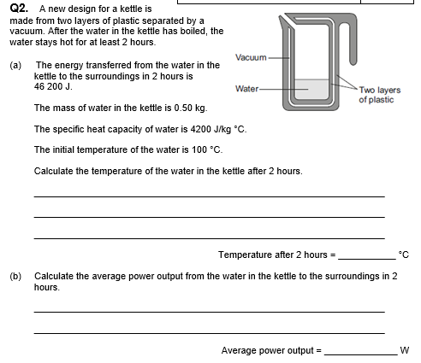
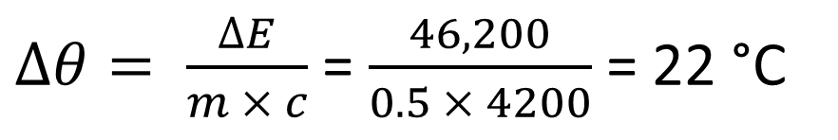
$∆θ= \frac{∆E}{m × c}$ = $\frac{46,200}{0.5 × 4200}$ = 22 °C
Temp after 2 hours = 100 – 22 = 78 °C
P = E ÷ t = 46,200 ÷ (2 × 60 × 60) = 46,200 ÷ 7200 = 6.4 Watts

Slide 16
Stretch
INDEPENDENT WORK
Professor Messer has an outdoor swimming pool, which contains
100 000 kg of water.
a) He needs to heat the water from 15°C
to 20°C. How much energy does he
need?
b) How much would this cost (in £) if
each MJ of electricity costs 3p?
c) On a hot summer day the sun shines
for 10 hours and the water absorbs
solar energy at a rate of 20 kW. How
much energy is absorbed that day?
d) By how much does the sun heat up
the water?

Slide 17
Stretch Review
DATA
m = 100 000 kg
cWATER = 4200 J/kg°C
Δθ = 20 - 15 = 5°C
3p = cost of 1 MJ = cost of 1 000 000 J
t = 10 hours = 36 000 s
P = 20 kW = 20 000 W
SOLUTION
a) ΔE = m x c x Δθ = 100 000 x 4200 x 5 = 2100 000 000 J = 2100 MJ
b) total cost = cost of 1 MJ x n° of MJ = 3p x 2100 = 6300 p = £ 63
c) E = P x t = 20 000 x 36 000 = 720 000 000 J = 720 MJ
d) Δθ = E ÷ (m x c) = 720 000 000 ÷ (100 000 x 4200) = 1.7 °C

