Slide 1
Specific heat capacity practical

Slide 2
Specific heat capacity
Energy
Joule
Mass
Kilogram
Temperature
Specific heat
Recall the apparatus needed to determine the specific heat capacity of an object.
Recall how to obtain thermal energy transfer from current, voltage and time.
Calculate the specific heat capacity of an object from the gradient of a temperature vs. work done graph.

Slide 3
Aim
AIM:
To determine the specific heat capacity of a block and to identify what material the block is made of.
V
12V
A
Stretch: To get an accurate reading, we do two things:
Wrap the block in an insulator.
Put oil in the hole with the thermometer.
Why?

Slide 4
What readings will we need to take?
ΔE = m x c x Δθ
Measure mass of block with a balance, temperature change with a thermometer.
Calculate energy change from E = I × V × t.
We don’t only want to take one reading, though. We want to take multiple readings, over multiple different energy transfers & temperatures. This reduces effect of random errors.

Slide 5
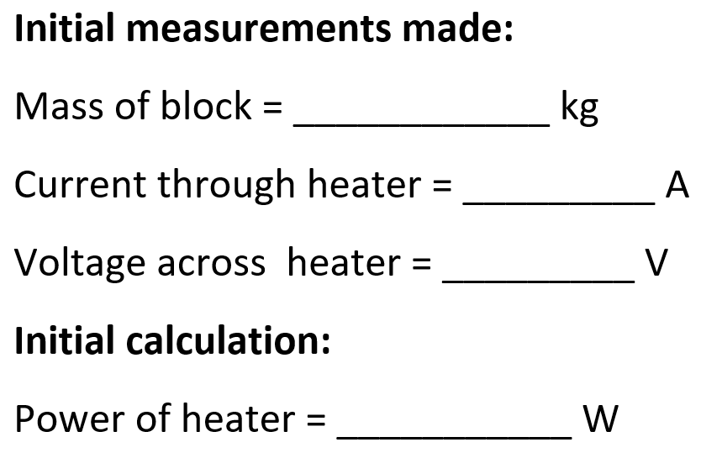
Initial measurements & calculations
1.006
3.25
11.30
36.7

Slide 6
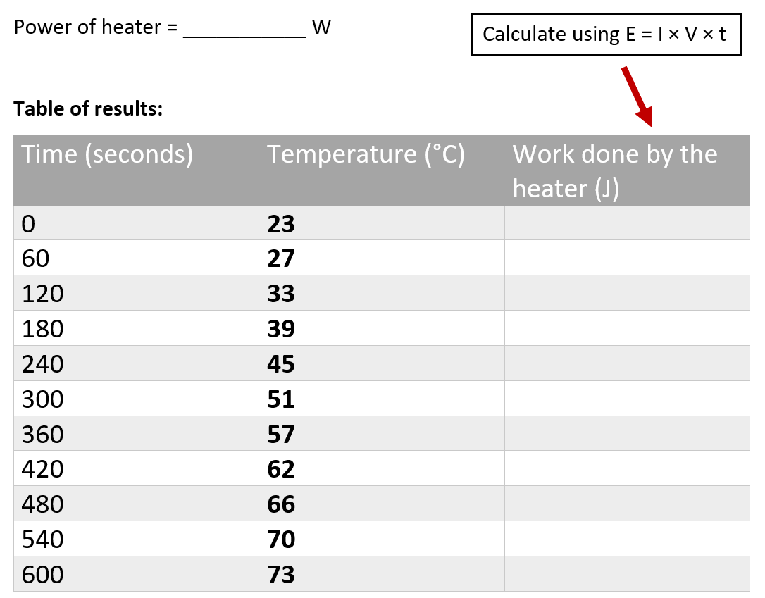
Specific heat capacity
Complete table of results

Slide 7

Graph
Temperature (°C) | Work done (J) (3 sf)
23 | 0
27 | 2200
33 | 4410
39 | 6610
45 | 8810
51 | 11,000
57 | 13,200
62 | 15,400
66 | 17,600
70 | 19,800
73 | 22,000
Work done (J)
0 5,000 10,000 15,000 20,000 25,000
0 10 20 30 40 50 60 70 80
Temperature (˚C)

Slide 8
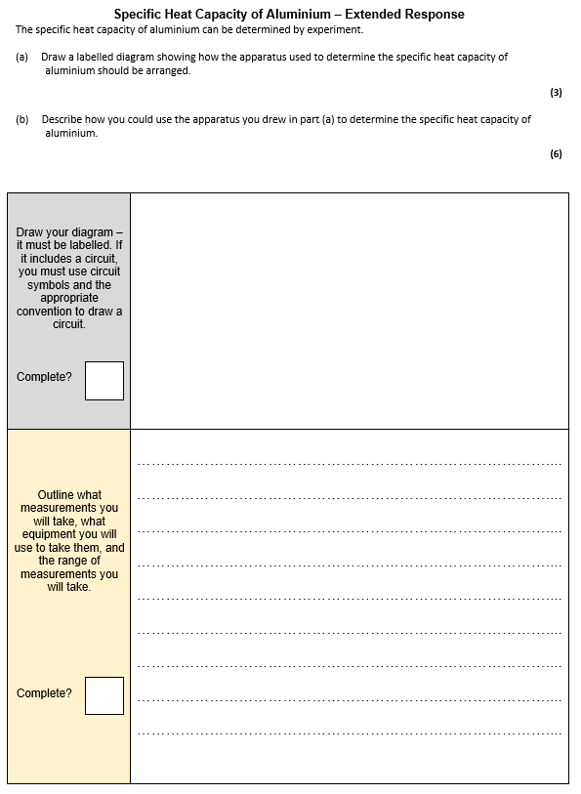
Worksheet
Complete the worksheet.

Slide 9

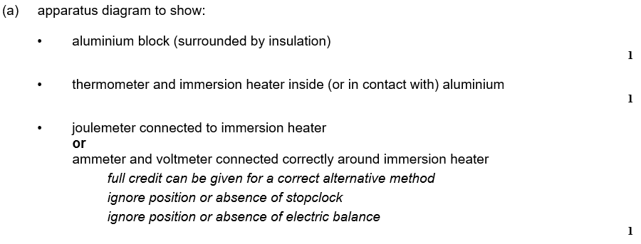
Worksheet answers

Slide 10
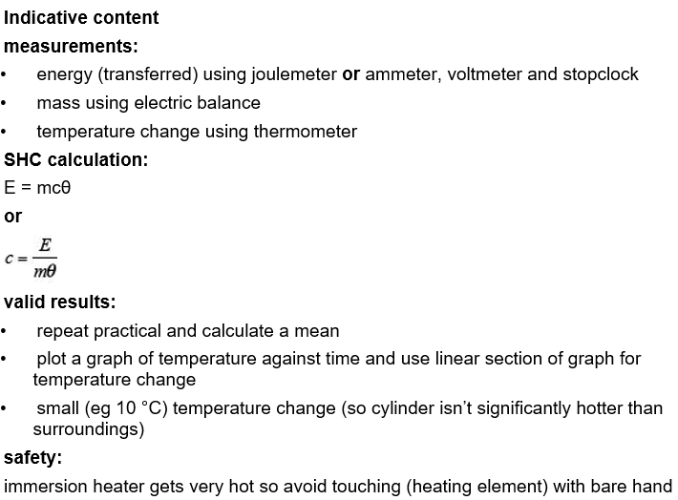
Worksheet answers

Slide 11
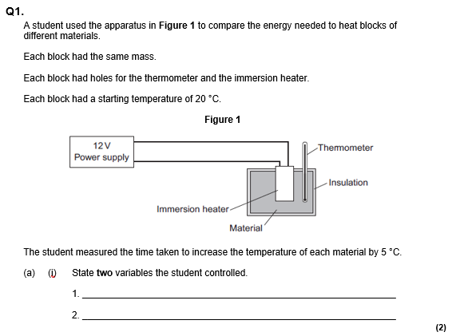
Struggle time!
Exam question so exam conditions!
You have 6 minutes!

Slide 12
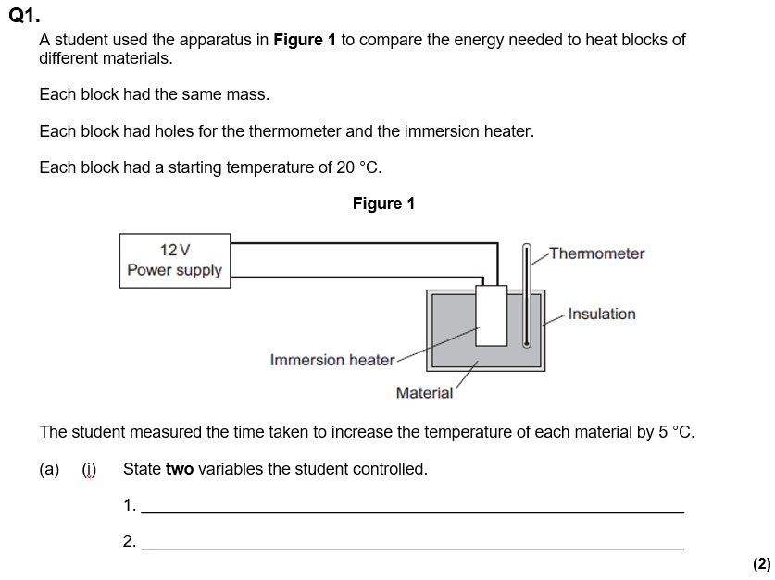
Struggle time review

Slide 13
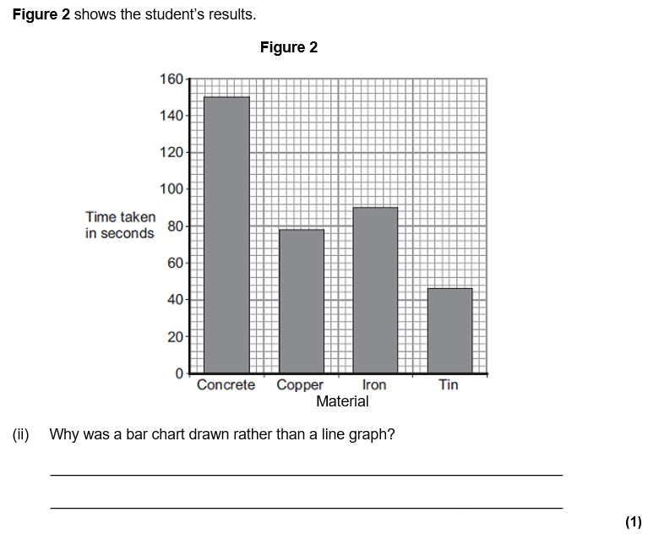
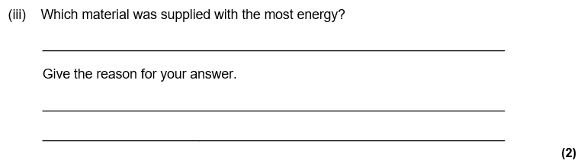
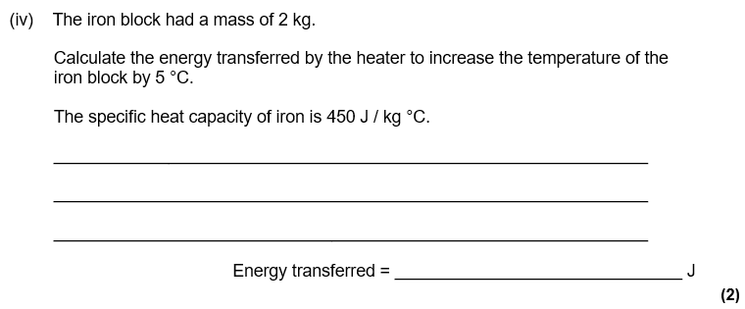

Slide 14
