Slide 1
Work done

Slide 2
Work
Energy
Joule
Force
Newton
State the factors that affect work done.
Recall the equation for work done.
Apply the equation for work done.

Slide 3
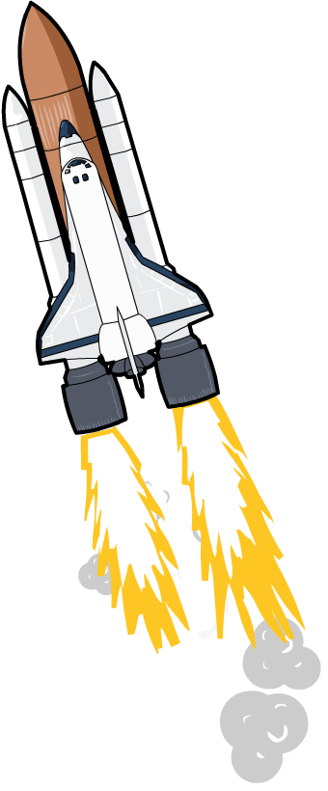
What is work?
What happens when a rocket is launched into space?
When the rocket’s engines are fired, chemical energy in the fuel is transferred to kinetic energy in the rocket.
This transfer of energy is called work.

Slide 4
Work done
Stretch: What’s more difficult?
-Lifting a 5 N weight or a 50 N weight?
-Lifting a 10 N weight by 10 cm or 1 m?
From this what two quantities do you think “work” depends on?
work done = energy transferred
This means the units for work are the same as the units for energy – joules.
For example, if a person does 500 J of work, then 500 J of energy is transferred.

Slide 5
Equation for work done
You have to remember this equation!
work done = force x distance moved
What are the units?
Work done is measured in joules (J).
Force is measured in newtons (N).
Distance moved is measured in metres (m).

Slide 6
Equation for work done
Rearrange the equation to give two more equations for Force and distance.
work done = force x distance moved
Stretch: Mo Farah uses 50,000 Joules of energy while running, at a force of 10 N. How far has he run?

Slide 7
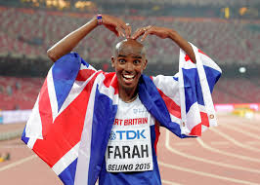
Stretch Review
Mo Farah uses 50,000 Joules of energy while running, at a force of 10 N. How far has he run?
STEP 1: Write down the equation that you need:
Distance = Work done ÷ Force
STEP 2: Put the variables into the equation:
Distance = 50,000 ÷ 10
STEP 3: Calculate the answer:
Distance = 5,000 m
Stretch: What is the answer in kilometres?

Slide 8
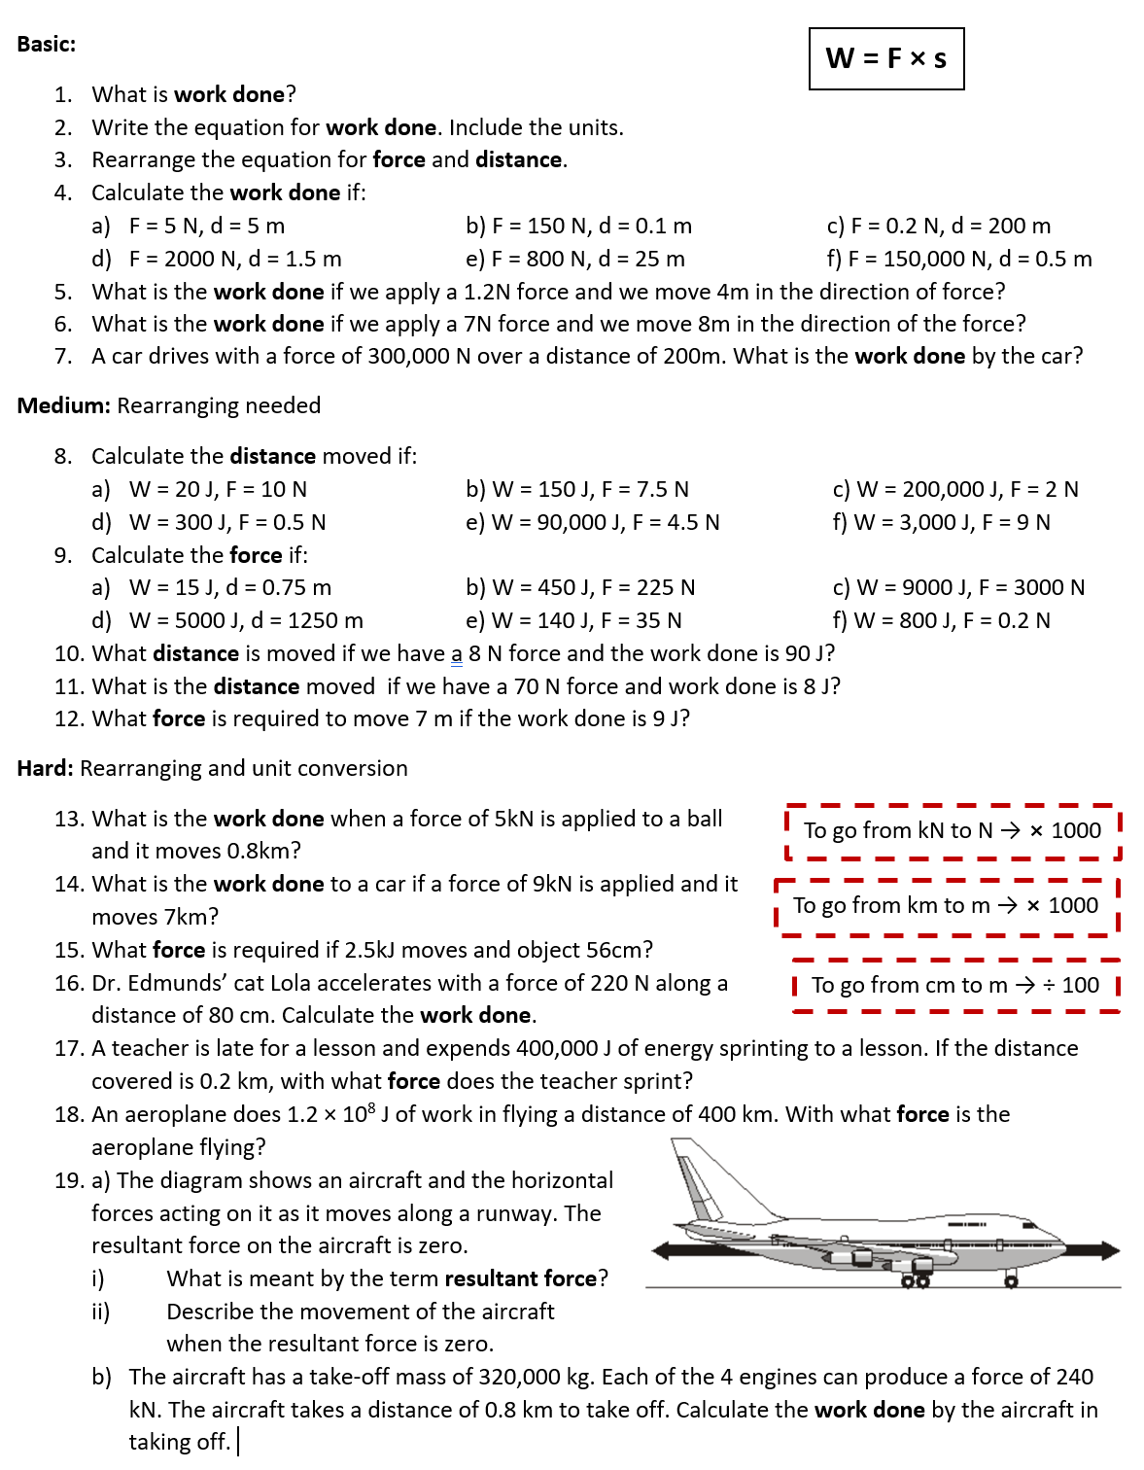
Worksheet
Complete the worksheet!

Slide 9

Basic answers
Work done is an energy transfer
W = F × s
F = W ÷ s, s = W ÷ s
a) 25 J b) 15 J c) 40 J
d) 3000 J e) 20,000 J f) 75,000 J
4.8 J
56 J
60,000,000 J

Slide 10
Medium answers
a) 2 m b) 20 m c) 100,000 m
d) 600 m e) 20,000 m f) 333.3 m
9. a) 2 N b) 2 N c) 3 N
d) 4 N e) 4 N f) 4,000 N
10. 11.25 m
11. 0.11 m
12. 1.29 m

Slide 11
Hard answers
13. 4,000,000 J
14. 63,000,000 J
15. 1,400 J
16. 44.6 N
17. 1760 J
18. 300N
19. a) i) Total overall force acting on an object.
ii) It moves at a constant velocity.
b) 768,000,000 J

Slide 12
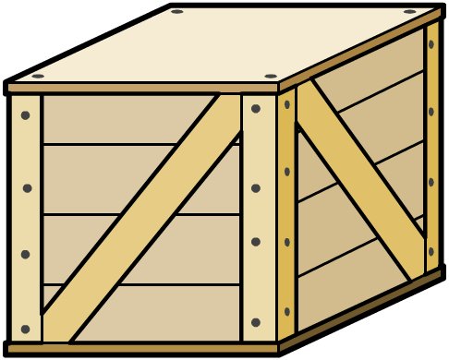
Resultant forces
The motion of the object will depend on the resultant force. This is calculated by adding all the forces together, taking their direction into account. When more than one force acts on an object, the forces COMBINE to form a RESULTANT FORCE
50 N
30 N
Resultant force on the crate = 50 N – 30 N
= 20 N to the left

Slide 13
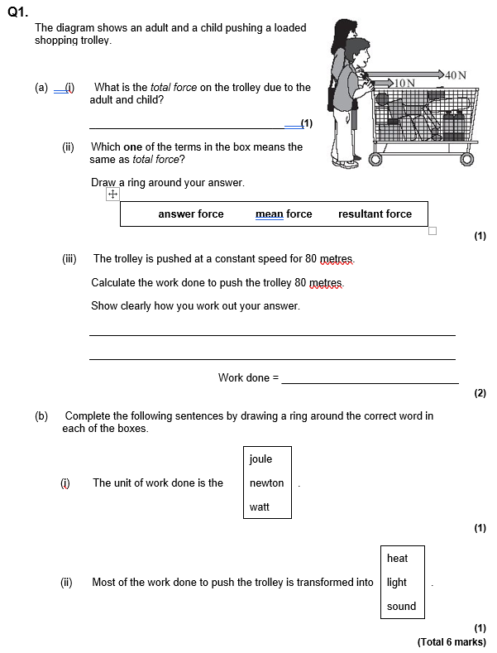
Struggle time
Exam questions so exam conditions!
You have 8 minutes.

Slide 14
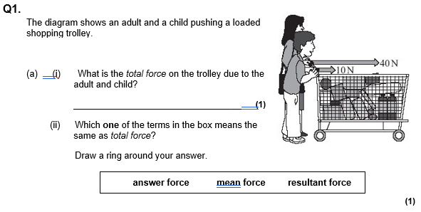
Struggle time review
40 + 10 = 50 N

Slide 15
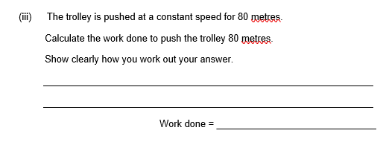
Struggle time review
Work done = Force × Distance
= 50 ⨯ 80 = 4,000 J

Slide 16
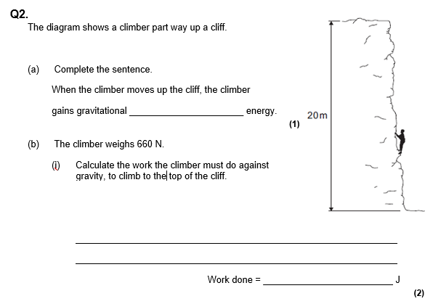
potential
Work done = Force × Distance
= 660 ⨯ 20 = 13,200 J

Slide 17
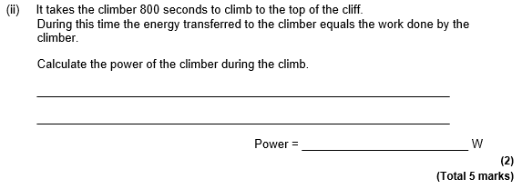
Struggle time review
Power = 13,200 ÷ 800 = 16.5 Watts (W)

