Slide 1
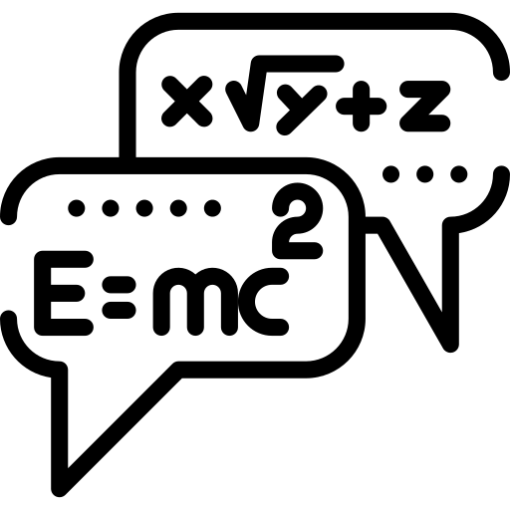





Physics Paper 2 revision booklet
Contents:
Thermal physics spec points and exam questions.
Fields and their consequences spec points and exam questions.
Nuclear physics spec points and exam questions.
How to use:
Answer the questions on the exam questions. Once answered, cover up the answers & check that you can do again.
Revising effectively does not simply involve reading over notes or making new notes – you have to practice answering questions & practice remembering information. To learn physics you have to do physics.

Slide 2
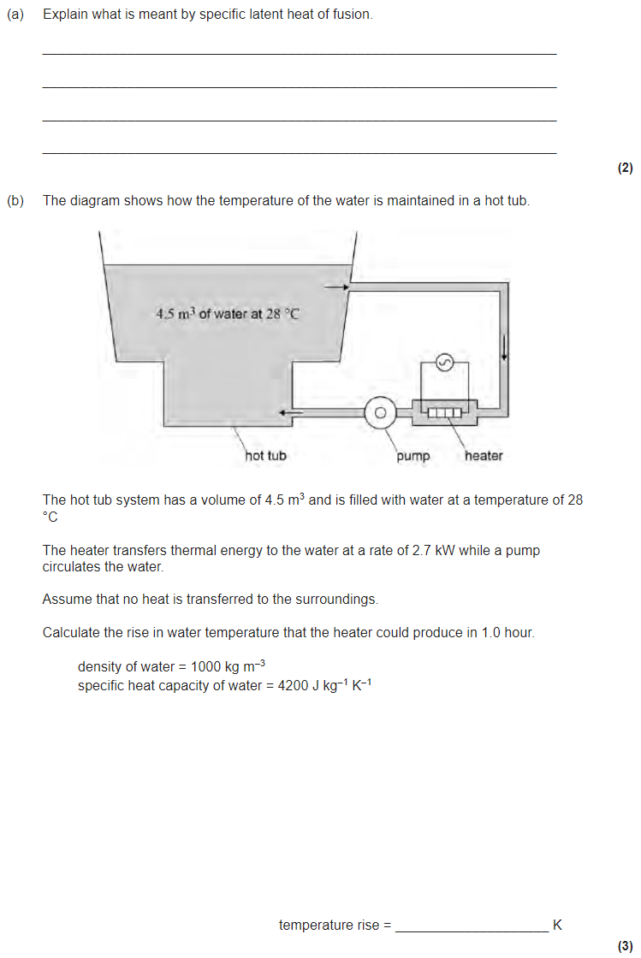
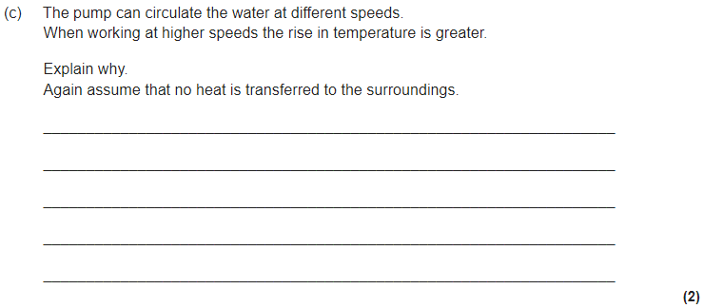
3.6.2.1 Thermal energy transfer
Internal energy is the sum of the randomly distributed kinetic energies and potential energies of the particles in a body.
The internal energy of a system is increased when energy is transferred to it by heating or when work is done on it (and vice versa), eg a qualitative treatment of the first law of thermodynamics.
Appreciation that during a change of state the potential energies of the particle ensemble are changing but not the kinetic energies. Calculations involving transfer of energy.
For a change of temperature: Q = mc Δθ where c is specific heat capacity.
Calculations including continuous flow.
For a change of state Q = ml where l is the specific latent heat.

Slide 3
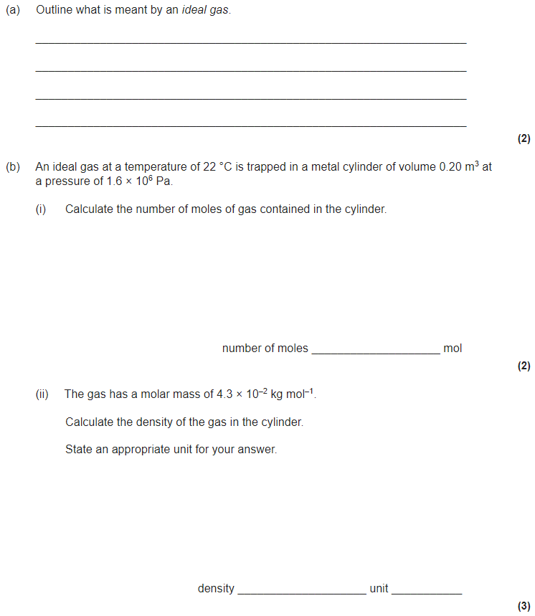
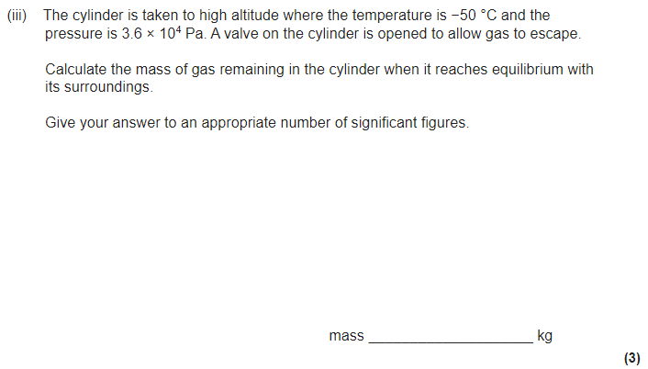
3.6.2.2 Ideal gases
Gas laws as experimental relationships between p, V, T and the mass of the gas.
Concept of absolute zero of temperature.
Ideal gas equation: pV = nRT for n moles and pV = NkT for N molecules.
Work done = pΔV
Avogadro constant N_{A}, molar gas constant R, Boltzmann constant k
Molar mass and molecular mass.
Required practical 8: Investigation of Boyle's law (constant temperature) and Charles’s law (constant pressure) for a gas.

Slide 4
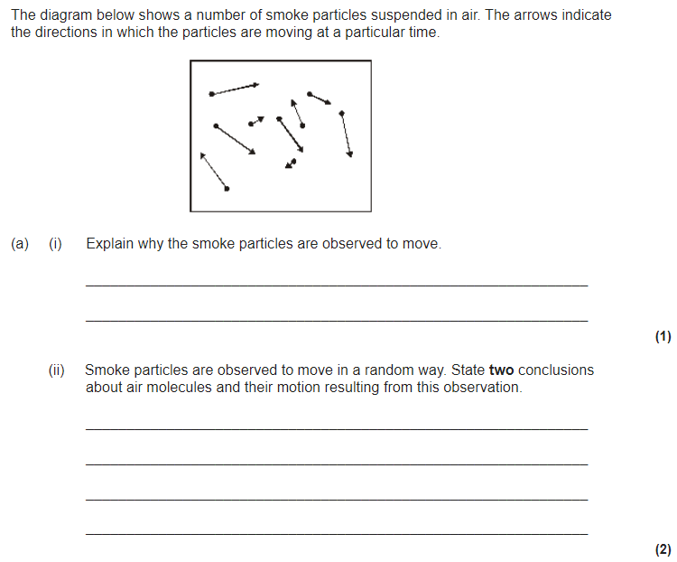
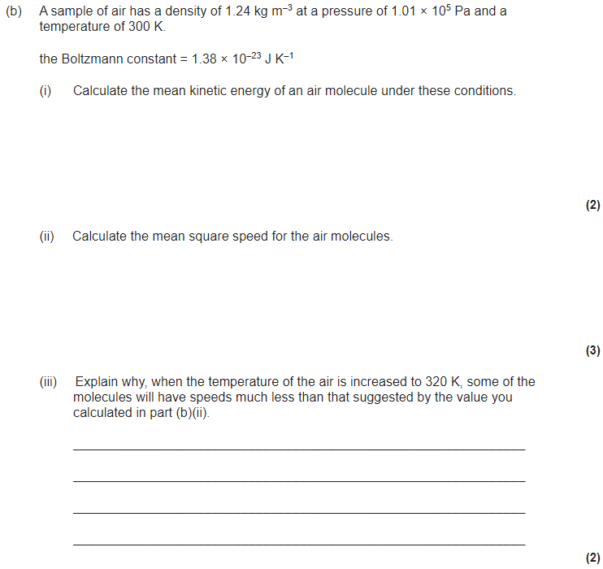
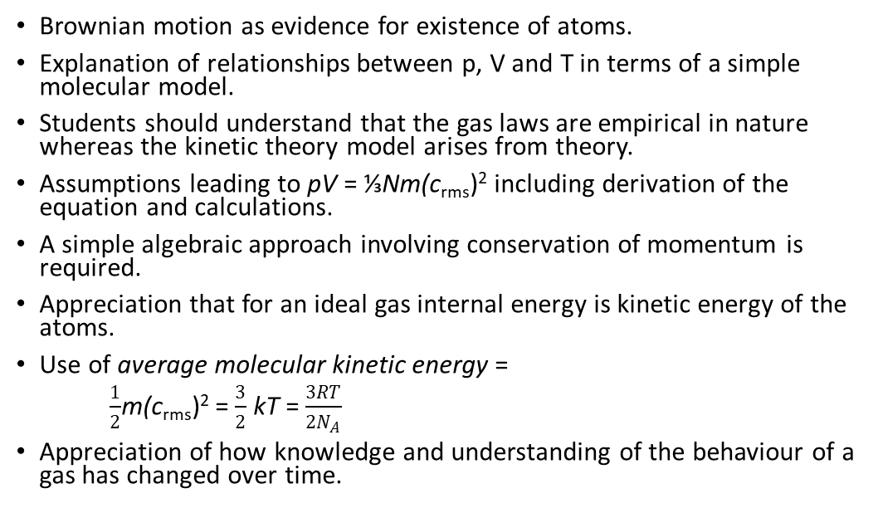
3.6.2.3 Molecular kinetic theory
Brownian motion as evidence for existence of atoms.
Explanation of relationships between p, V and T in terms of a simple molecular model.
Students should understand that the gas laws are empirical in nature whereas the kinetic theory model arises from theory.
Assumptions leading to pV = ⅓Nm(c_{rms})² including derivation of the equation and calculations.
A simple algebraic approach involving conservation of momentum is required.
Appreciation that for an ideal gas internal energy is kinetic energy of the atoms.
Use of average molecular kinetic energy =
$\frac{1}{2}$m(c_{rms})² = $\frac{3}{2}$ kT = $\frac{3RT}{2N_{A}}$
Appreciation of how knowledge and understanding of the behaviour of a gas has changed over time.

Slide 5
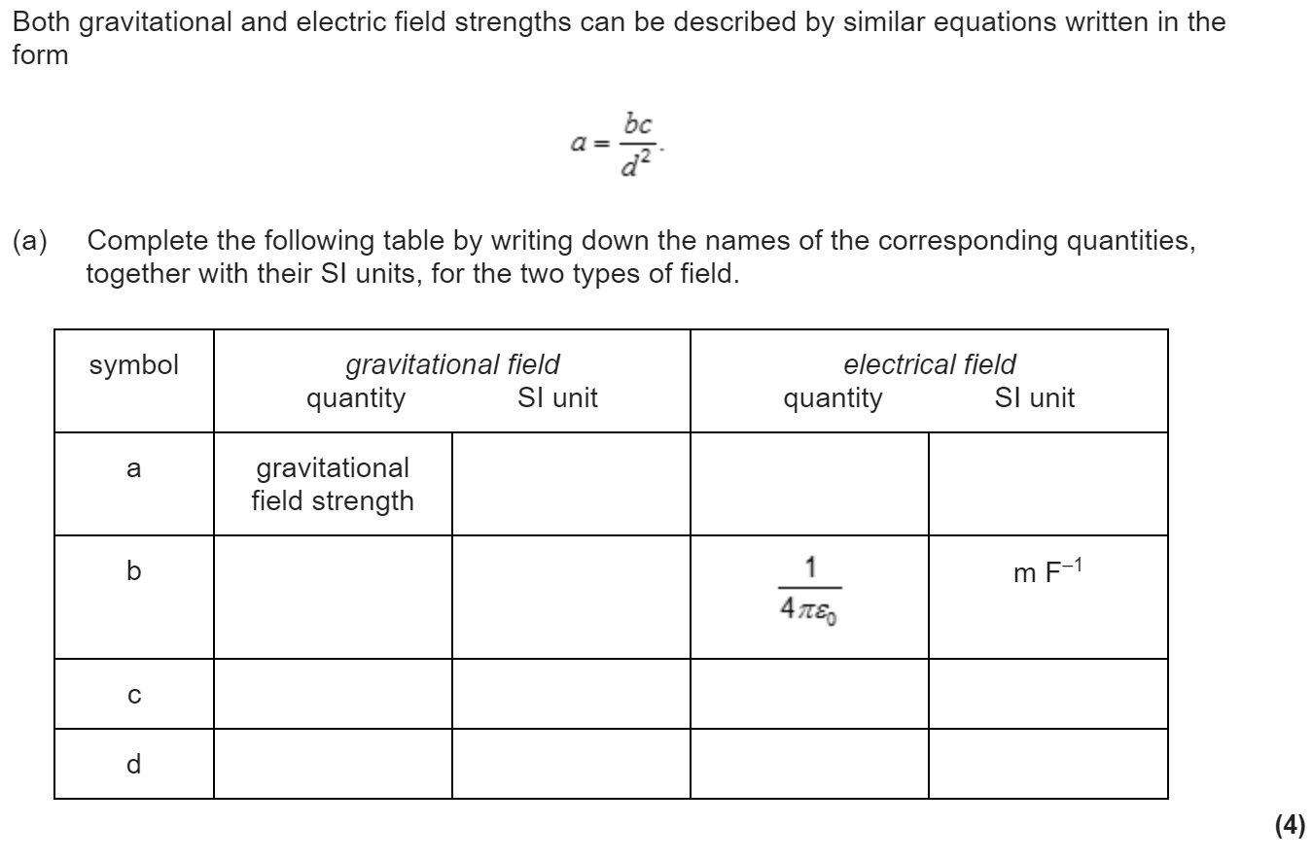
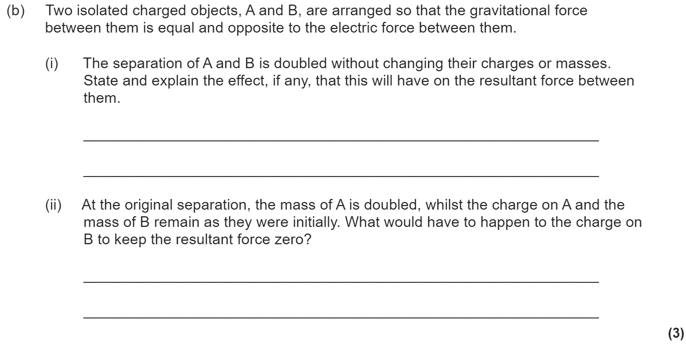
3.7.1 Fields
Concept of a force field as a region in which a body experiences a non-contact force.
Students should recognise that a force field can be represented as a vector, the direction of which must be determined by inspection.
Force fields arise from the interaction of mass, of static charge, and between moving charges.
Similarities and differences between gravitational and electrostatic forces:
Similarities: Both have inverse-square force laws that have many characteristics in common, eg use of field lines, use of potential concept, equipotential surfaces etc
Differences: masses always attract, but charges may attract or repel

Slide 6
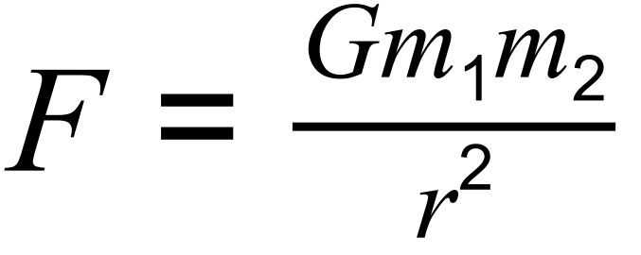
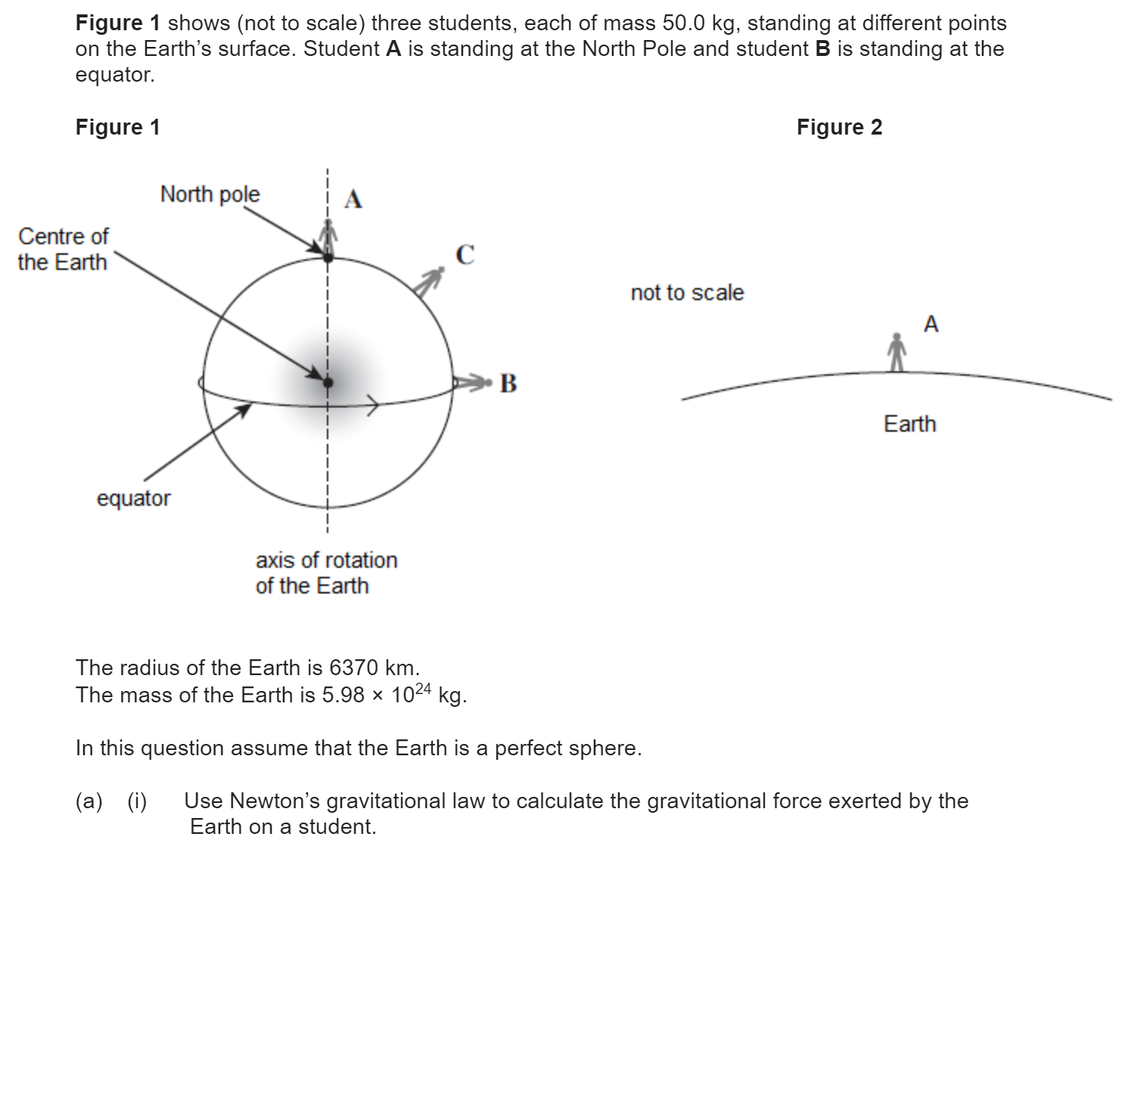
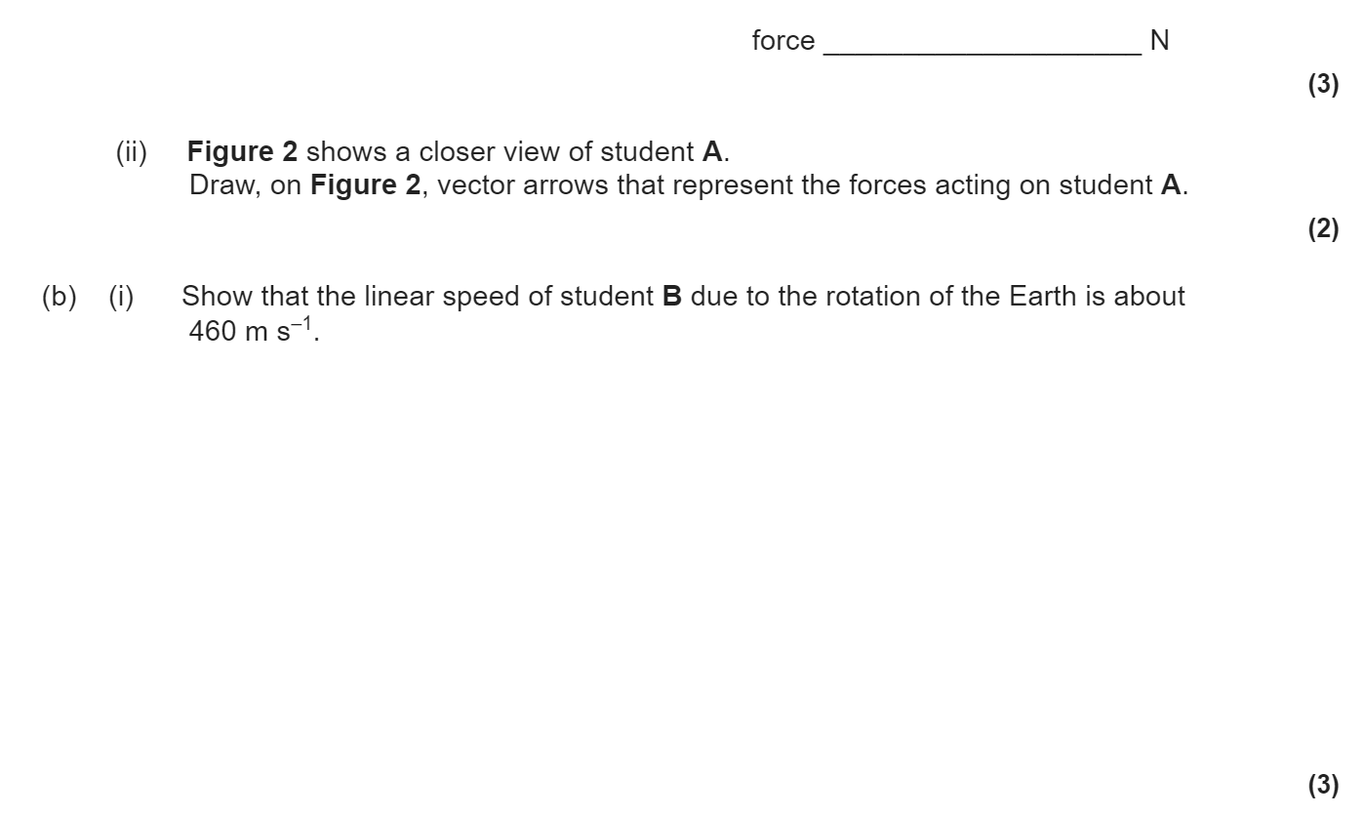
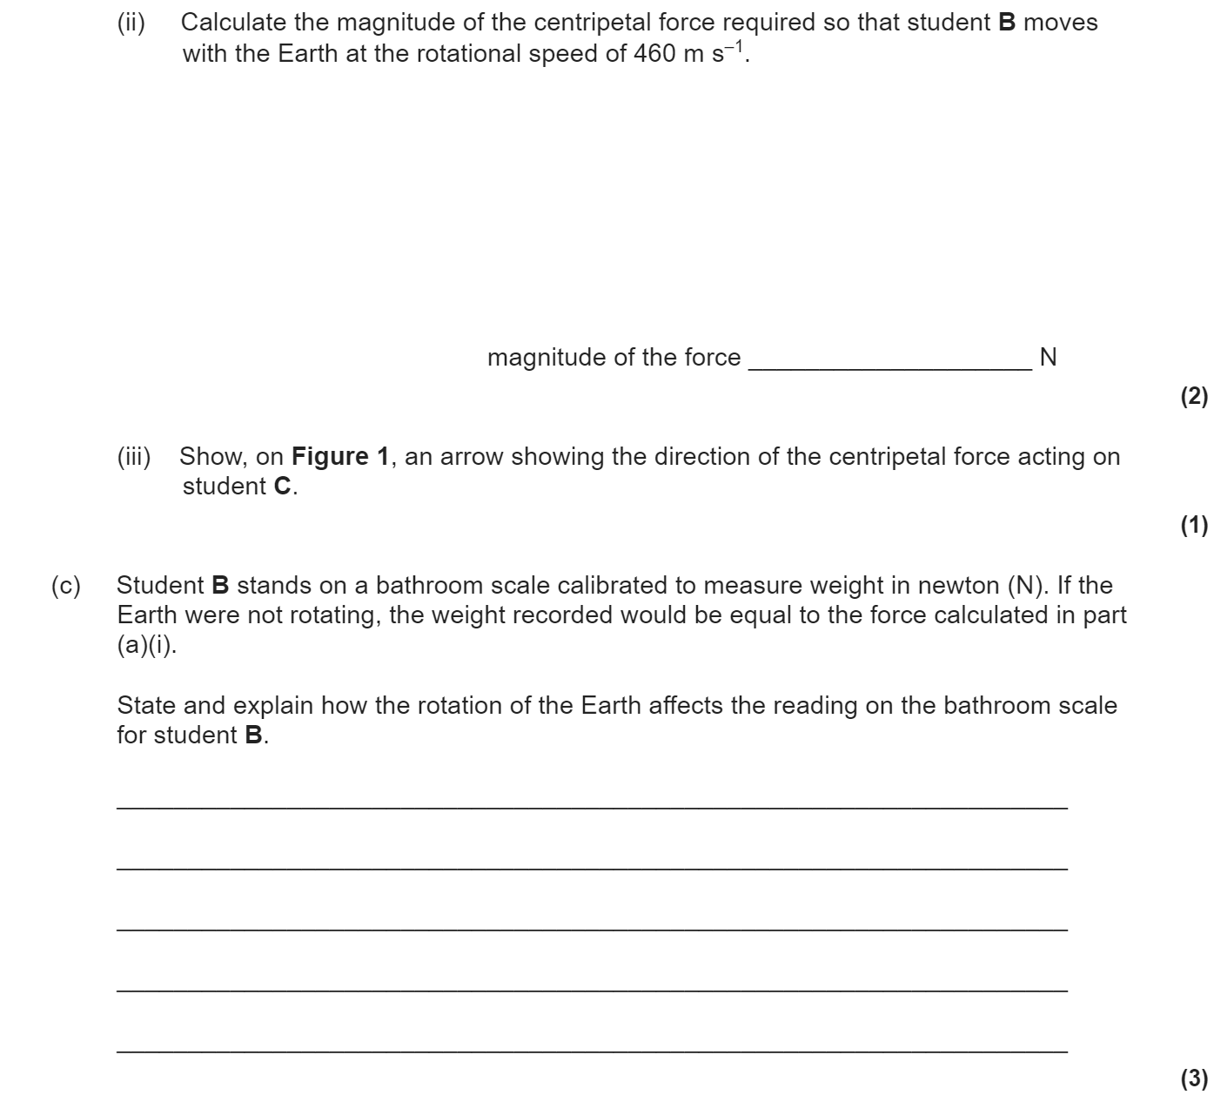
3.7.2.1 Newton’s law
Gravity as a universal attractive force acting between all matter.
Magnitude of force between point masses:
where G is the gravitational constant.

Slide 7
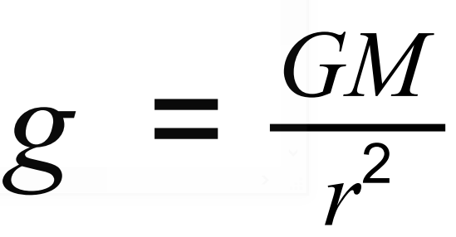
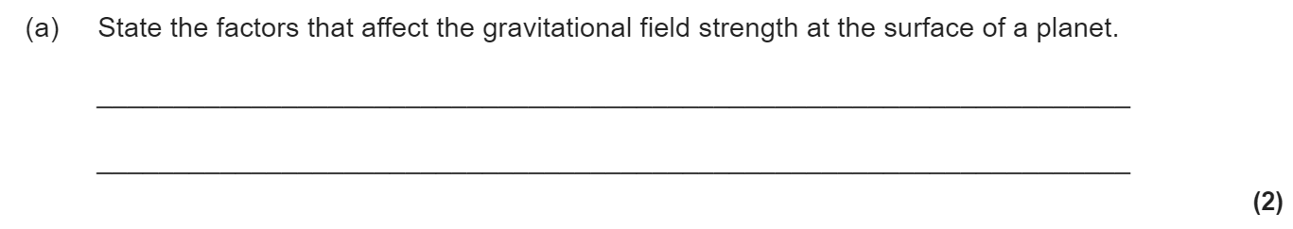
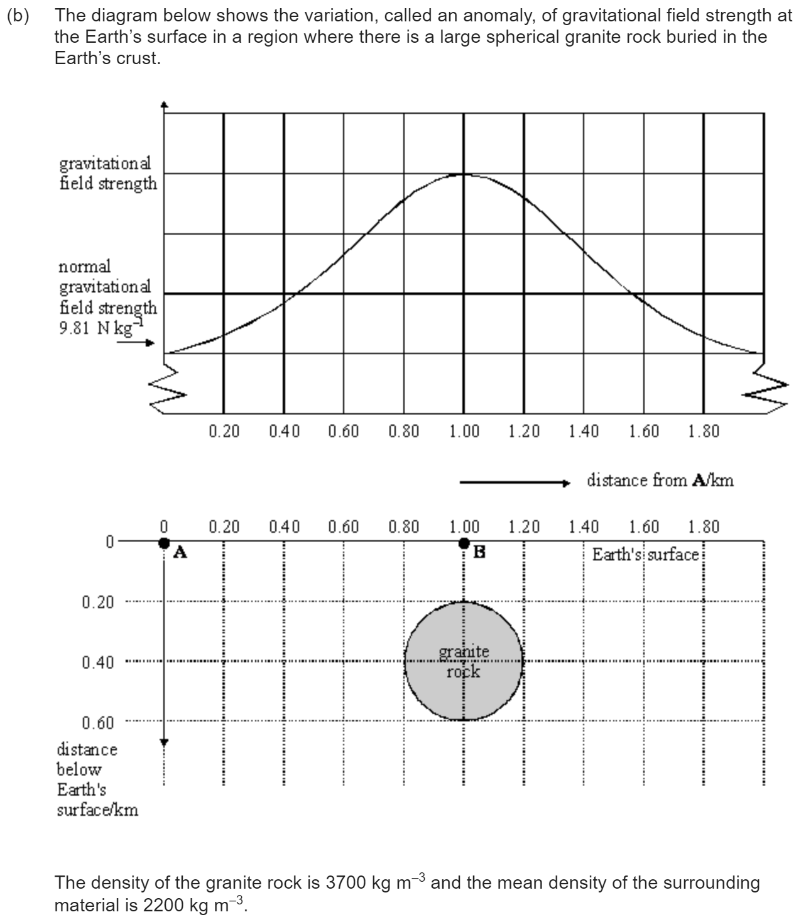
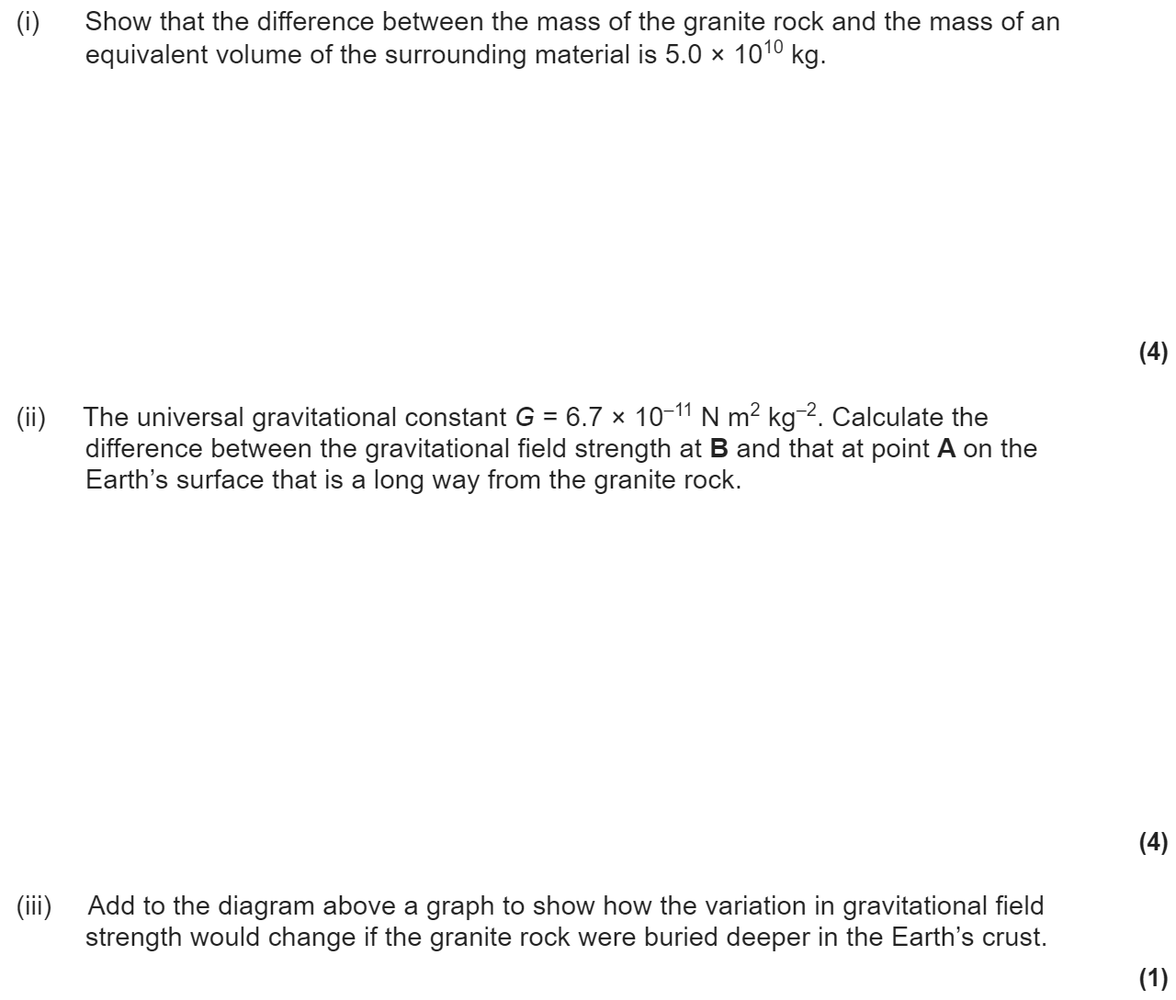
3.7.2.2 Gravitational field strength
Representation of a gravitational field by gravitational field lines.
g as force per unit mass as defined by g = F/m
Magnitude of g in a radial field given by

Slide 8
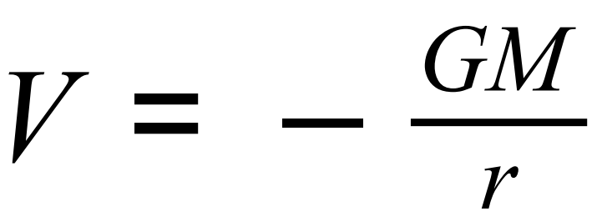
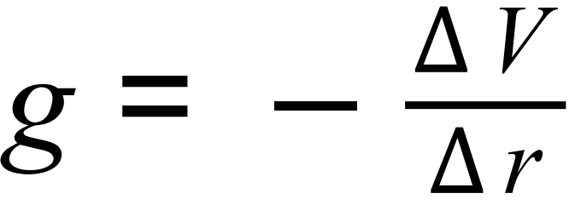
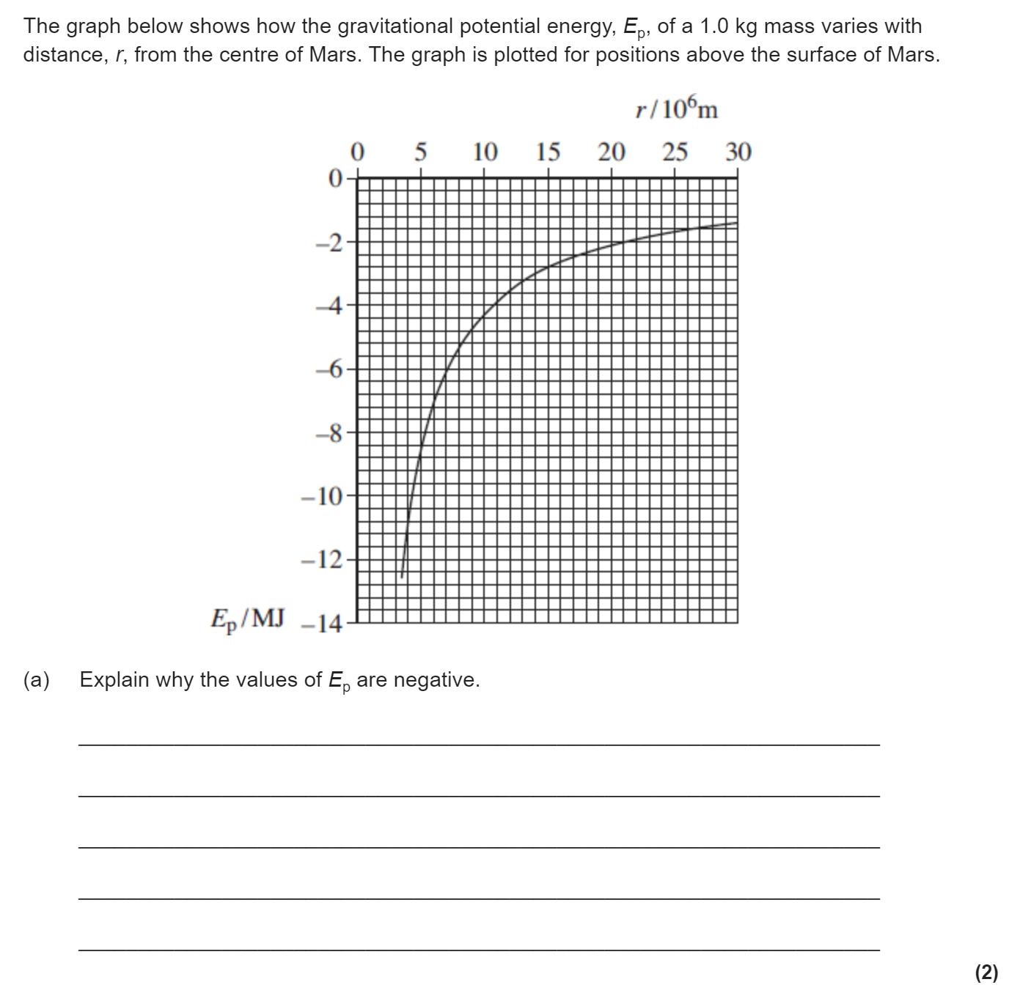
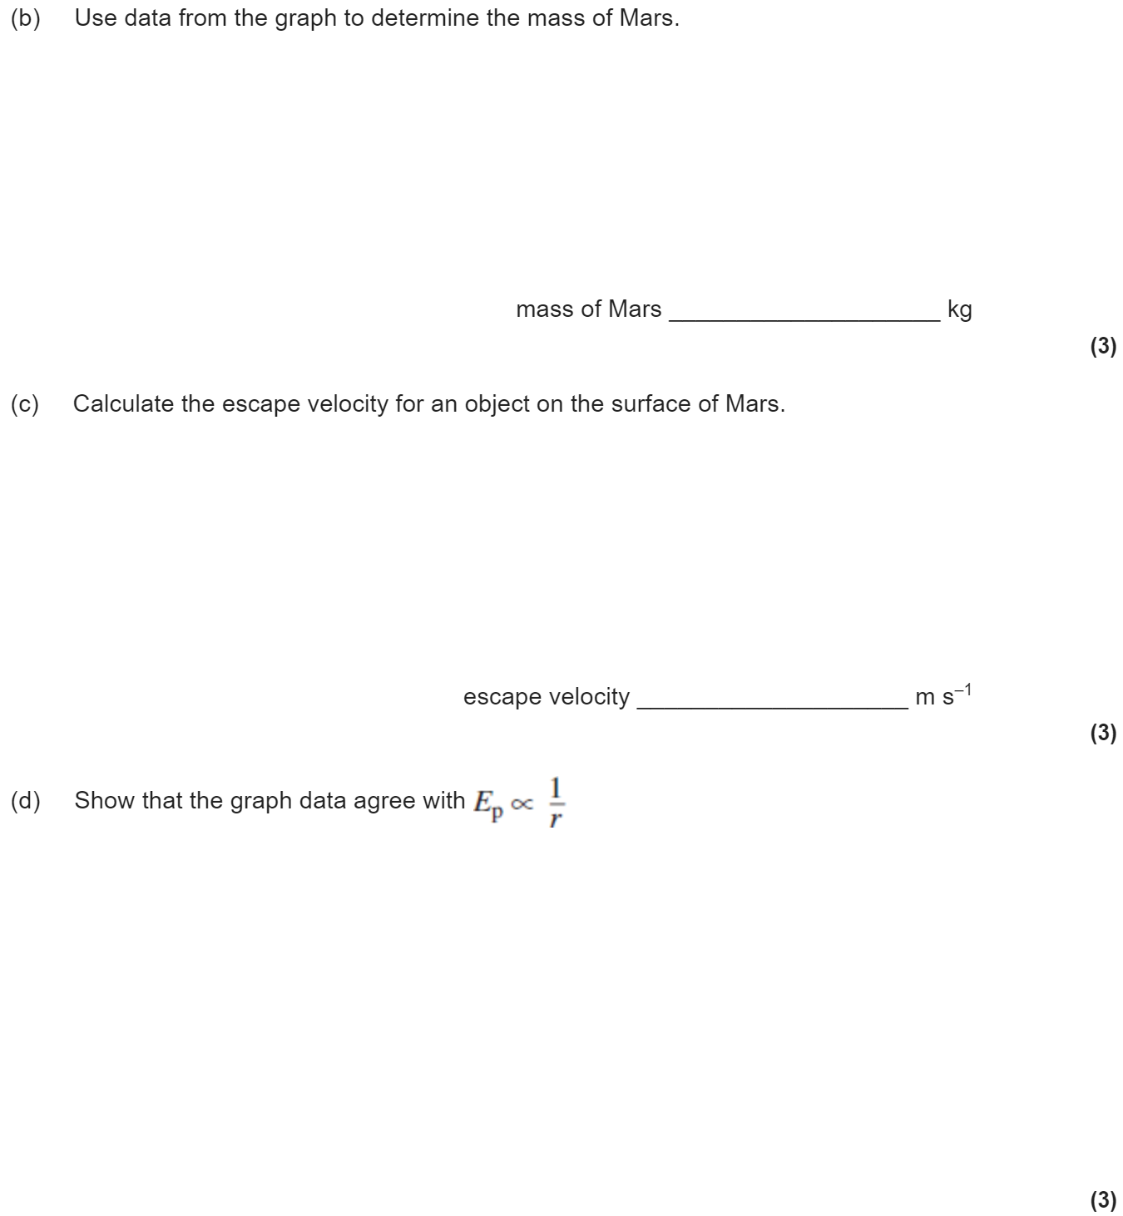
3.7.2.3 Gravitational potential
Understanding of definition of gravitational potential, including zero value at infinity.
Understanding of gravitational potential difference.
Work done in moving mass m given by ∆W = m∆V.
Equipotential surfaces.
Idea that no work is done when moving along an equipotential surface.
V in a radial field given by
Significance of the negative sign.
Graphical representations of variations of g and V with r.
V related to g by:
∆ V from area under graph of g against r.

Slide 9
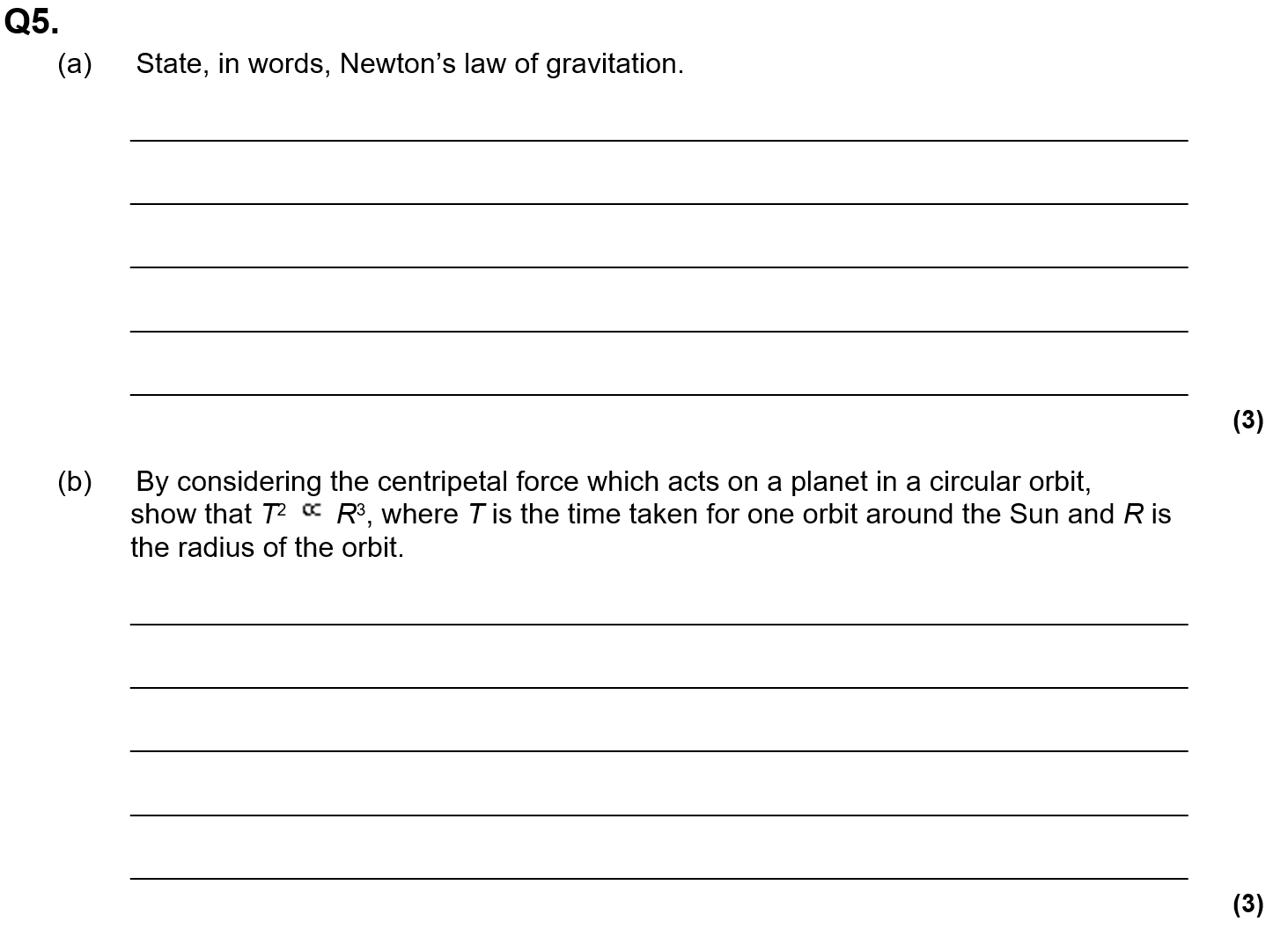
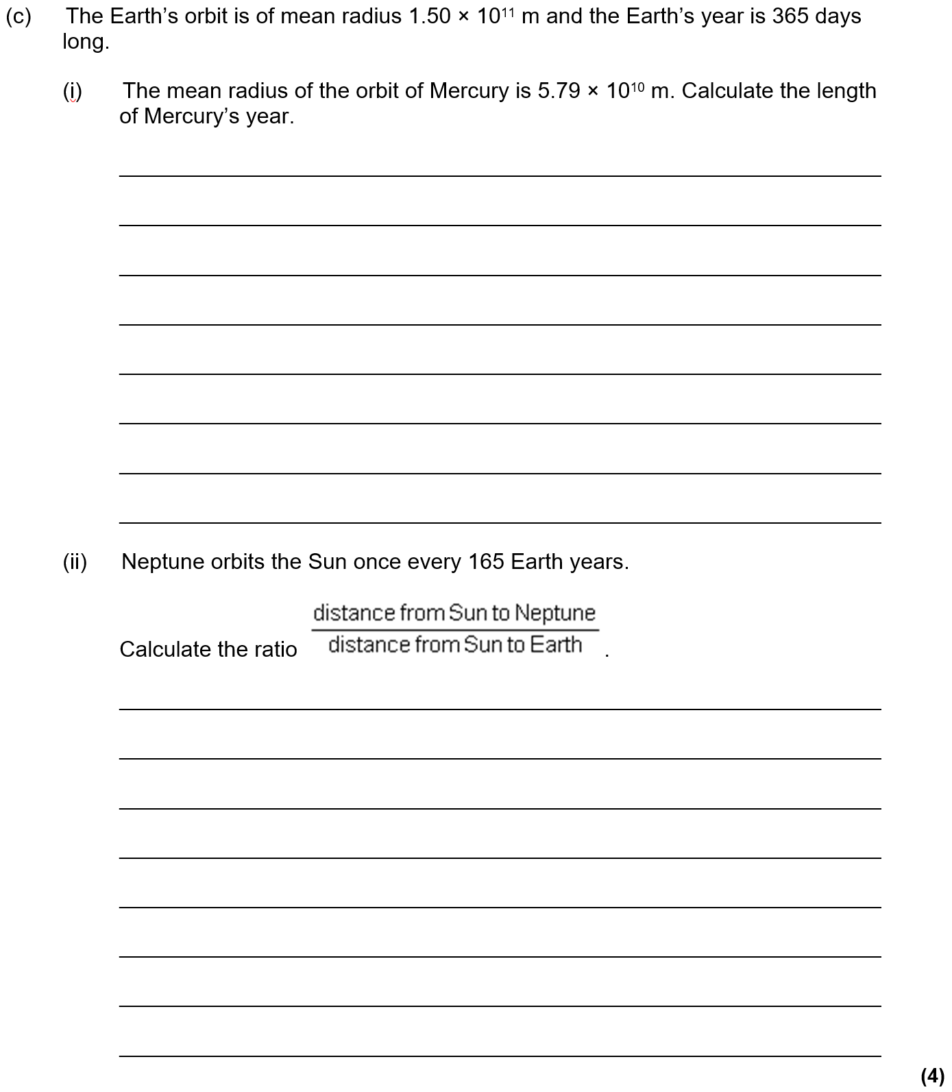
3.7.2.4 Orbits of planets and satellites
Orbital period and speed related to radius of circular orbit; derivation of T² ∝ r³
Energy considerations for an orbiting satellite.
Total energy of an orbiting satellite.
Escape velocity.
Synchronous orbits.
Use of satellites in low orbits and geostationary orbits, to include plane and radius of geostationary orbit.

Slide 10
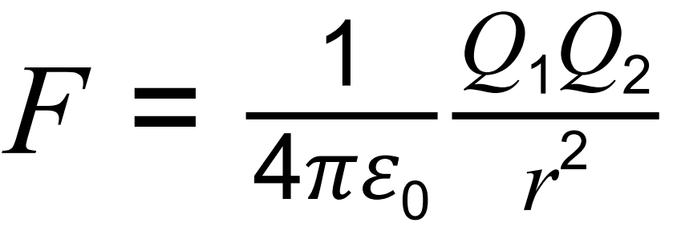
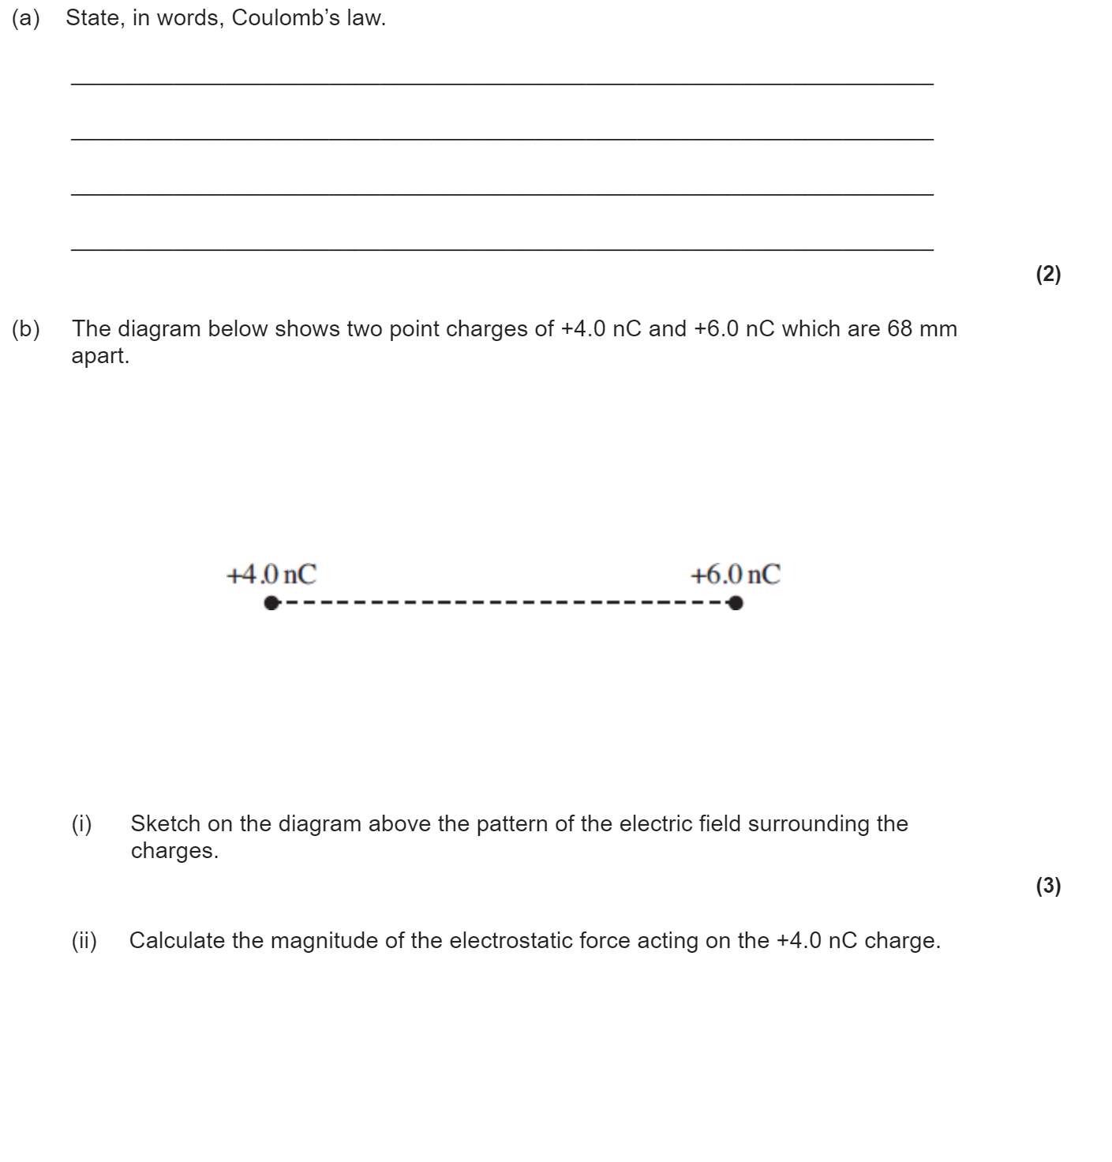
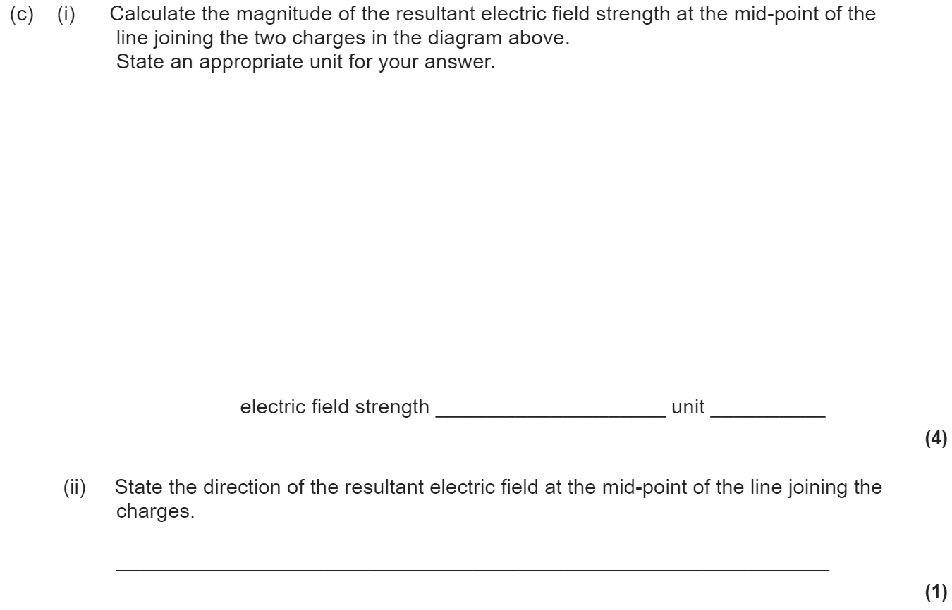
3.7.3.1 Coulomb’s law
Force between point charges in a vacuum:
Permittivity of free space, ε₀.
Appreciation that air can be treated as a vacuum when calculating force between charges.
For a charged sphere, charge may be considered to be at the centre.
Comparison of magnitude of gravitational and electrostatic forces between subatomic particles.

Slide 11
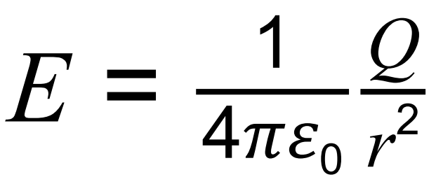
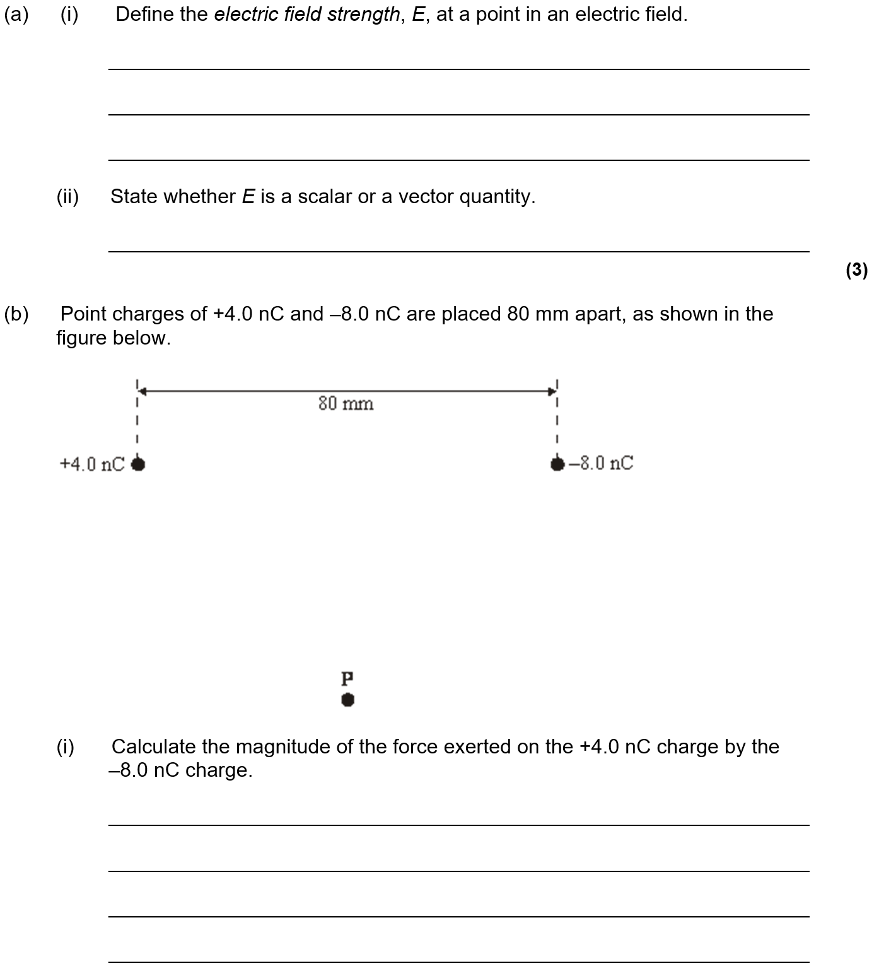
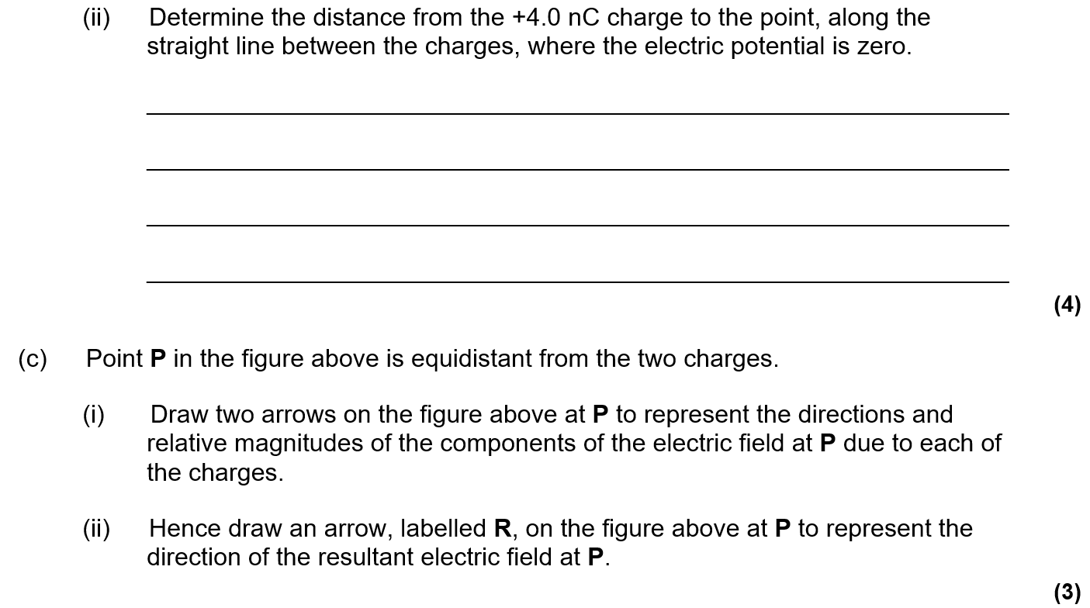
3.7.3.2 Electric field strength
Representation of electric fields by electric field lines.
Electric field strength.
E as force per unit charge defined by E = F/Q
Magnitude of E in a uniform field given by E = V/d
Derivation from work done moving charge between plates: Fd = QΔV
Trajectory of moving charged particle entering a uniform electric field initially at right angles.
Magnitude of E in a radial field given by

Slide 12
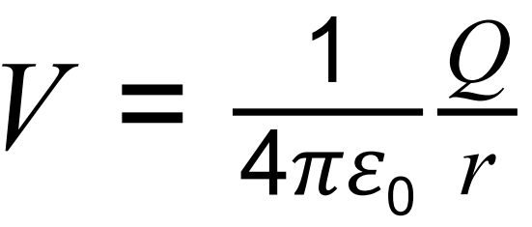
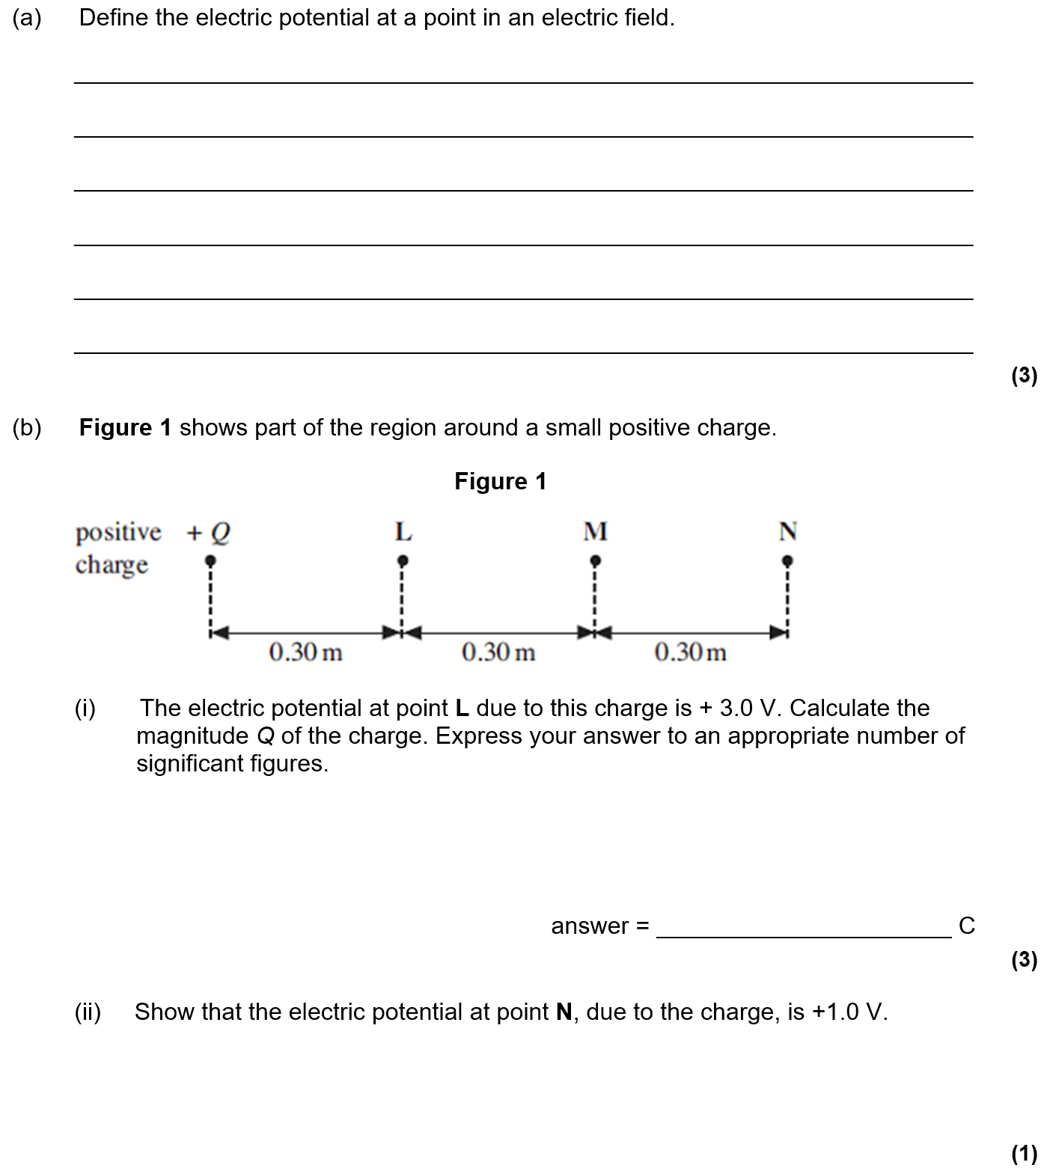
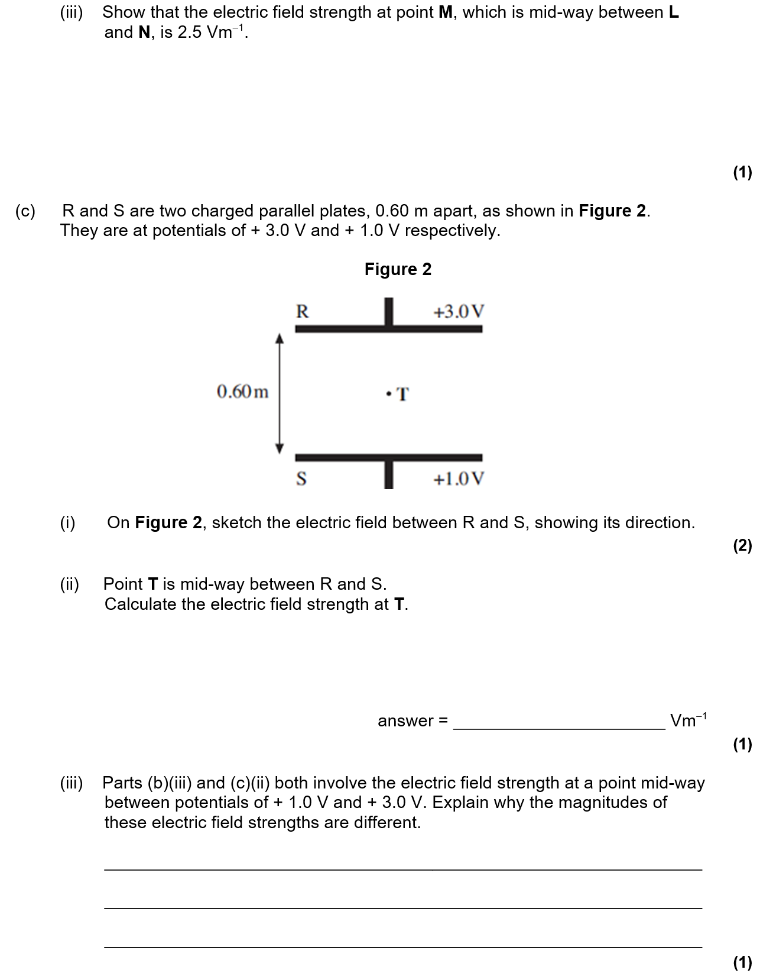
3.7.3.3 Electric potential
Understanding of definition of absolute electric potential, including zero value at infinity, and of electric potential difference.
Work done in moving charge Q given by ∆W = Q∆V
Equipotential surfaces.
No work done moving charge along an equipotential surface.
Magnitude of V in a radial field given by
Graphical representations of variations of E and V with r.
V related to E by E = ∆V/∆r
∆V from the area under graph of E against r.

Slide 13
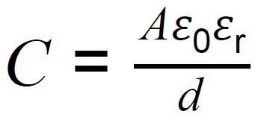
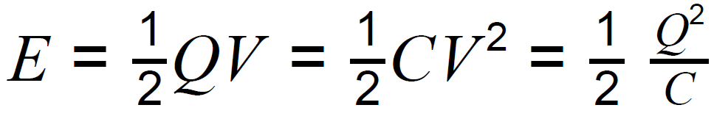
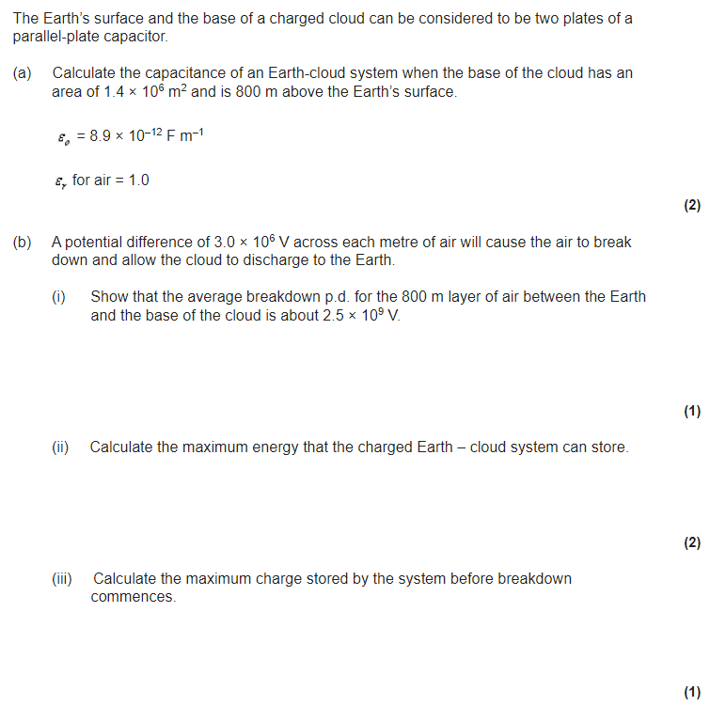
3.7.4.1 Capacitance
Definition of capacitance: C = Q/V
3.7.4.2 Parallel plate capacitor
Dielectric action in a capacitor
Relative permittivity and dielectric constant.
Students should be able to describe the action of a simple polar molecule that rotates in the presence of an electric field.
3.7.4.3 Energy stored by a capacitor
Interpretation of the area under a graph of charge against pd.

Slide 14


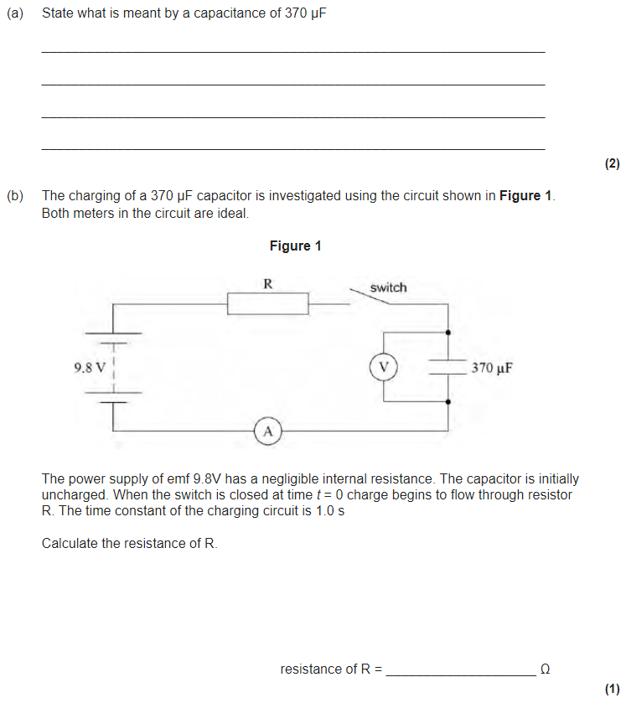
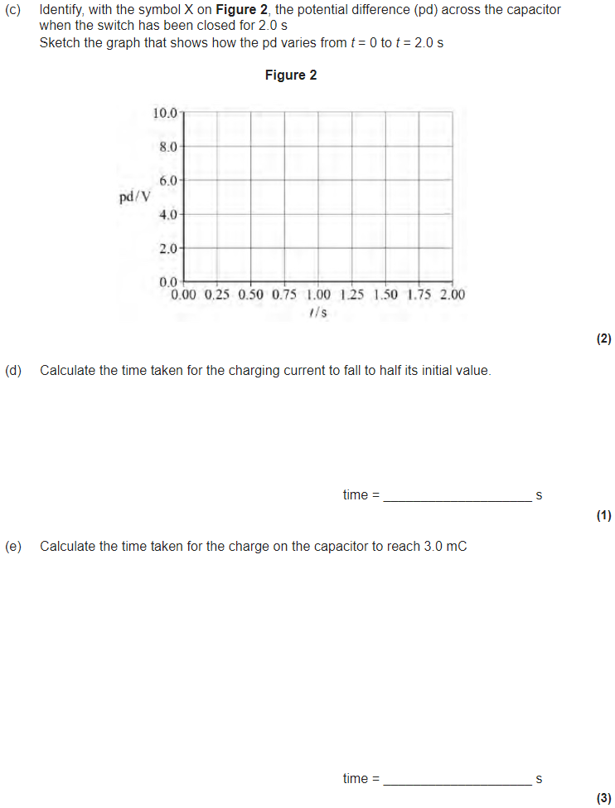
3.7.4.4 Capacitor charge and discharge
Graphical representation of charging and discharging of capacitors through resistors. Corresponding graphs for Q, V and I against time for charging and discharging.
Interpretation of gradients and areas under graphs where appropriate.
Time constant RC.
Calculation of time constants including their determination from graphical data.
Time to halve, T_{½} = 0.69RC
Quantitative treatment of capacitor discharge
Use of the corresponding equations for V and I.
Quantitative treatment of capacitor charge
Required practical 9: Investigation of the charge and discharge of capacitors. Analysis techniques should include log-linear plotting leading to a determination of the time constant, RC.

Slide 15
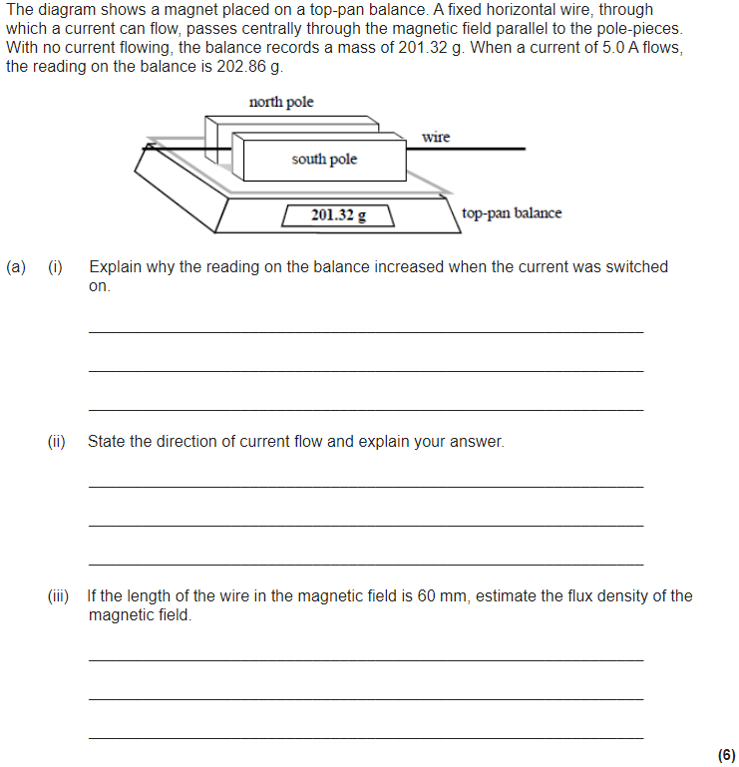
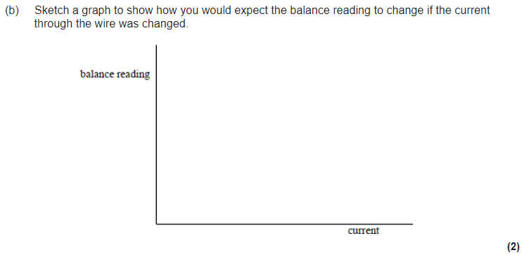
3.7.5.1 Magnetic flux density
Force on a current-carrying wire in a magnetic field: F = BIl when field is perpendicular to current.
Fleming’s left hand rule.
Magnetic flux density B and definition of the tesla.
Required practical 10: Investigate how the force on a wire varies with flux density, current and length of wire using a top pan balance.

Slide 16
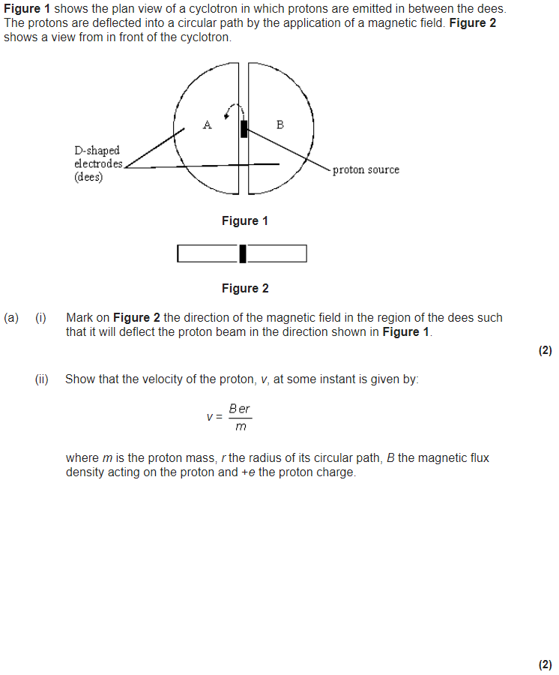
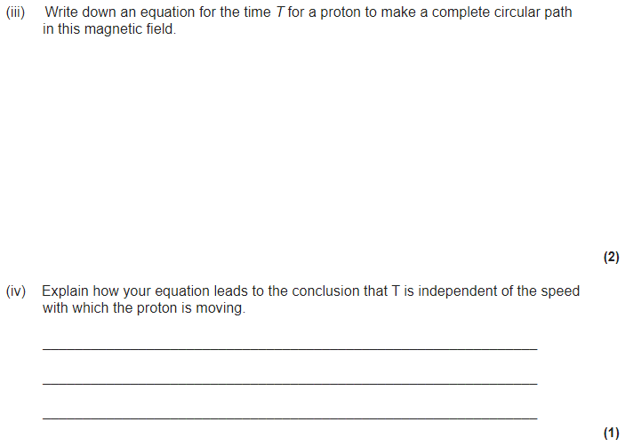
3.7.5.2 Moving charges in a B field
Force on charged particles moving in a magnetic field, F = BQv when the field is perpendicular to velocity.
Direction of force on positive and negative charged particles.
Circular path of particles; application in devices such as the cyclotron.

Slide 17
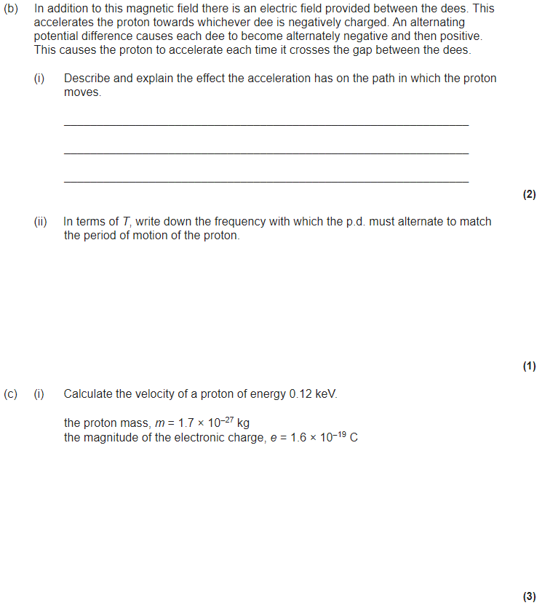
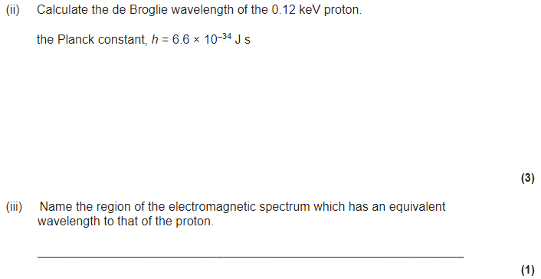

Slide 18
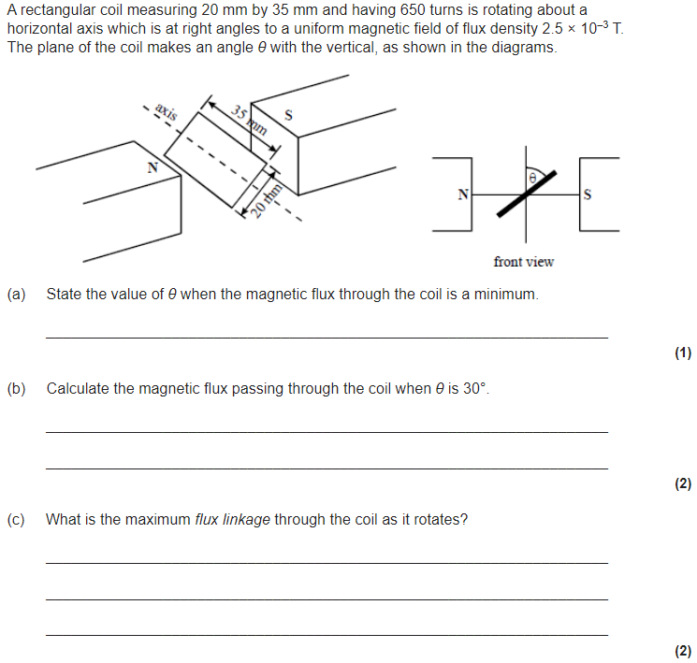
3.7.5.3 Magnetic flux and flux linkage
Magnetic flux defined by φ = BA where B is normal to A.
Flux linkage as Nφ where N is the number of turns cutting the flux.
Flux and flux linkage passing through a rectangular coil rotated in a magnetic field: flux linkage Nφ = BANcosθ
Required practical 11: Investigate, using a search coil and oscilloscope, the effect on magnetic flux linkage of varying the angle between a search coil and magnetic field direction.

Slide 19
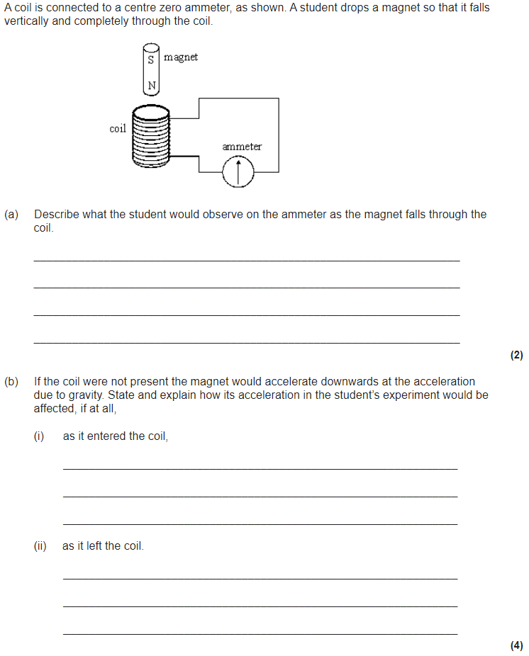
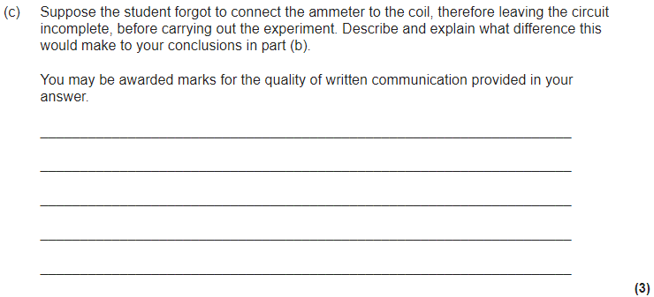
3.7.5.4 Electromagnetic induction
Simple experimental phenomena.
Faraday’s and Lenz’s laws.
Magnitude of induced emf = rate of change of flux linkage
ε = NΔφ / Δ t
Applications such as a straight conductor moving in a magnetic field.
emf induced in a coil rotating uniformly in a magnetic field: ε = BANωsin ωt

Slide 20

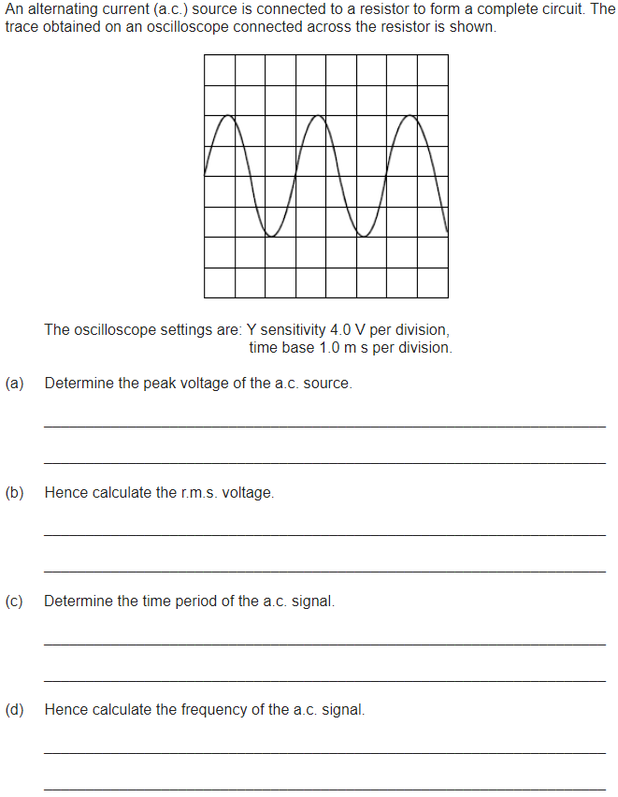
3.7.5.5 Alternating currents
Sinusoidal voltages and currents only; root mean square, peak and peak-to-peak values for sinusoidal waveforms only.
Application to the calculation of mains electricity peak and peak-to-peak voltage values.
Use of an oscilloscope as a dc and ac voltmeter, to measure time intervals and frequencies, and to display ac waveforms.
No details of the structure of the instrument are required but familiarity with the operation of the controls is expected.

Slide 21
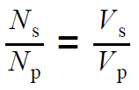

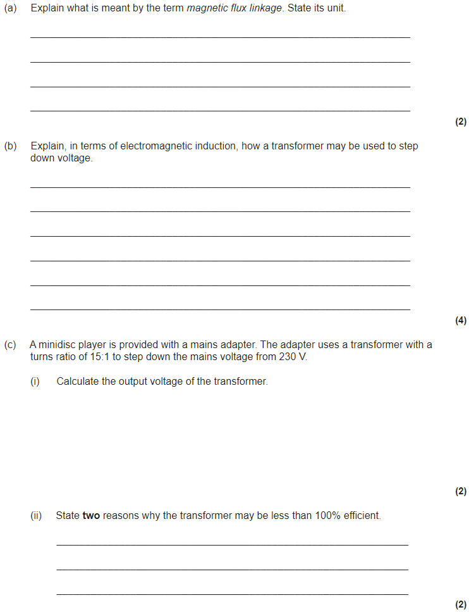
3.7.5.6 The operation of a transformer
The transformer equation:
Transformer efficiency =
Production of eddy currents.
Causes of inefficiencies in a transformer.
Transmission of electrical power at high voltage including calculations of power loss in transmission lines.

Slide 22


3.8.1.1 Rutherford scattering
Qualitative study of Rutherford scattering.
Appreciation of how knowledge and understanding of the structure of the nucleus has changed over time.

Slide 23



3.8.1.2 α, β and γ radiation
Their properties and experimental identification using simple absorption experiments; applications eg to relative hazards of exposure to humans.
Applications also include thickness measurements of aluminium foil paper and steel.
Inverse-square law for γ radiation:
Experimental verification of inverse-square law.
Applications eg to safe handling of radioactive sources.
Background radiation; examples of its origins and experimental elimination from calculations.
Appreciation of balance between risk and benefits in the uses of radiation in medicine.
Required practical 12: Investigation of the inverse-square law for gamma radiation.

Slide 24





3.8.1.3 Radioactive decay
Random nature of radioactive decay; constant decay probability of a given nucleus;
Use of activity, A = λN
Modelling with constant decay probability.
Questions may be set which require students to use
Questions may also involve use of molar mass or the Avogadro constant.
Half-life equation:
Determination of half-life from graphical decay data including decay curves and log graphs.
Applications eg relevance to storage of radioactive waste, radioactive dating etc.

Slide 25

3.8.1.4 Nuclear instability
Graph of N against Z for stable nuclei.
Possible decay modes of unstable nuclei including α, β⁺, β⁻ and electron capture.
Changes in N and Z caused by radioactive decay and representation in simple decay equations.
Questions may use nuclear energy level diagrams.
Existence of nuclear excited states; γ ray emission; application eg use of technetium-99m as a γ source in medical diagnosis.

Slide 26


3.8.1.5 Nuclear radius
Estimate of radius from closest approach of alpha particles and determination of radius from electron diffraction.
Knowledge of typical values for nuclear radius.
Students will need to be familiar with the Coulomb equation for the closest approach estimate.
Dependence of radius on nucleon number:
R = R₀A^{⅓} derived from experimental data.
Interpretation of equation as evidence for constant density of nuclear material.
Calculation of nuclear density.
Students should be familiar with the graph of intensity against angle for electron diffraction by a nucleus.

Slide 27



3.8.1.6 Mass and energy
Appreciation that E = mc² applies to all energy changes,
Simple calculations involving mass difference and binding energy.
Atomic mass unit, u.
Conversion of units; 1 u = 931.5 MeV.
Fission and fusion processes.
Simple calculations from nuclear masses of energy released in fission and fusion reactions.
Graph of average binding energy per nucleon against nucleon number.
Students may be expected to identify, on the plot, the regions where nuclei will release energy when undergoing fission/fusion.
Appreciation that knowledge of the physics of nuclear energy allows society to use science to inform decision making.

Slide 28

3.8.1.7 Induced fission
Fission induced by thermal neutrons; possibility of a chain reaction; critical mass.
The functions of the moderator, control rods, and coolant in a thermal nuclear reactor.
Details of particular reactors are not required.
Students should have studied a simple mechanical model of moderation by elastic collisions.
Factors affecting the choice of materials for the moderator, control rods and coolant. Examples of materials used for these functions.

Slide 29

3.8.1.8 Safety aspects
Fuel used, remote handling of fuel, shielding, emergency shut-down.
Production, remote handling, and storage of radioactive waste materials.
Appreciation of balance between risk and benefits in the development of nuclear power.

Slide 30


