Slide 1
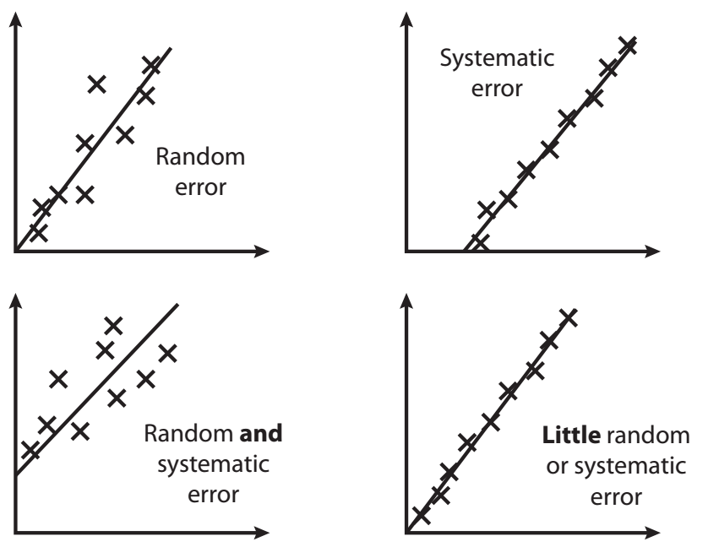
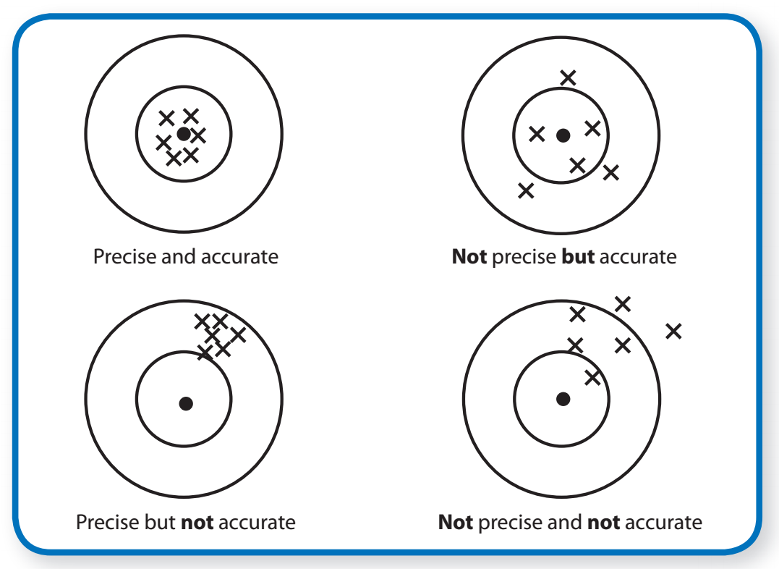

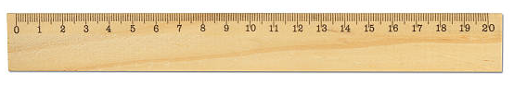
Errors
14/09/2022
What does resolution mean?
What is the absolute uncertainty of a ruler? Why?
What is a systematic error?
What is a random error?
What does precise mean?
What does accurate mean?

Slide 2
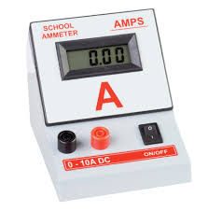
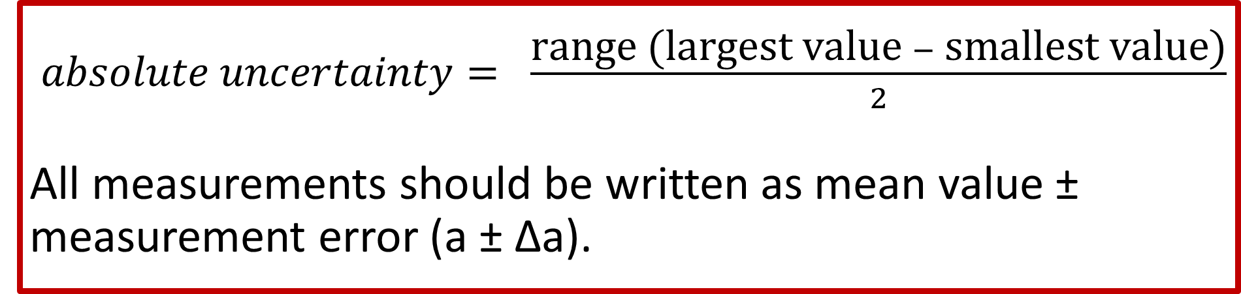
$absolute uncertainty= \frac{\text{range}\text{ (}\text{largest} \text{value} − \text{smallest} \text{value}\text{)}}{2}$
All measurements should be written as mean value ± measurement error (a ± Δa).
Stretch: An ammeter has reading of 13.13 A, 12.89 A, 12.59 A, 13.43 A and 13.04 A. Give the mean value and the measurement error.

Slide 3
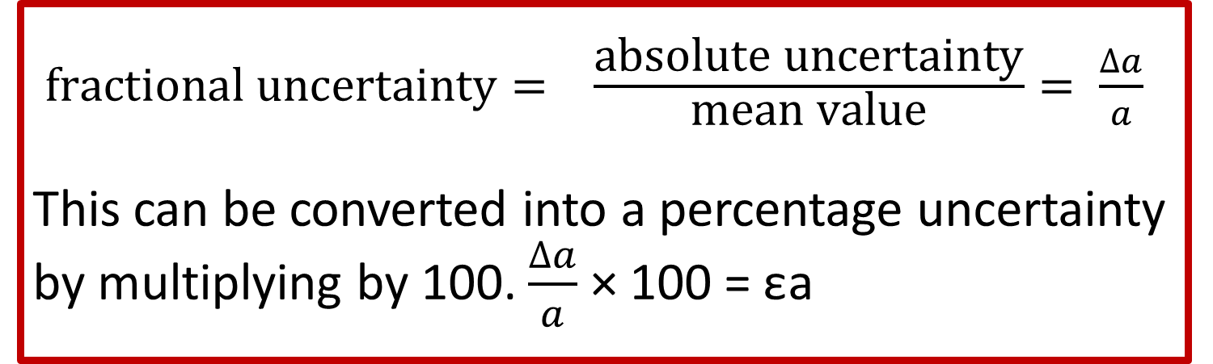
$fractional uncertainty= \frac{\text{absolute} \text{uncertainty}}{\text{mean} \text{value}}= \frac{∆a}{a}$
This can be converted into a percentage uncertainty by multiplying by 100. $\frac{∆a}{a}$ × 100 = εa
Stretch: An ammeter has reading of 13.13 A, 12.89 A, 12.59 A, 13.43 A and 13.04 A. Give the fractional and percentage uncertainties.

Slide 4
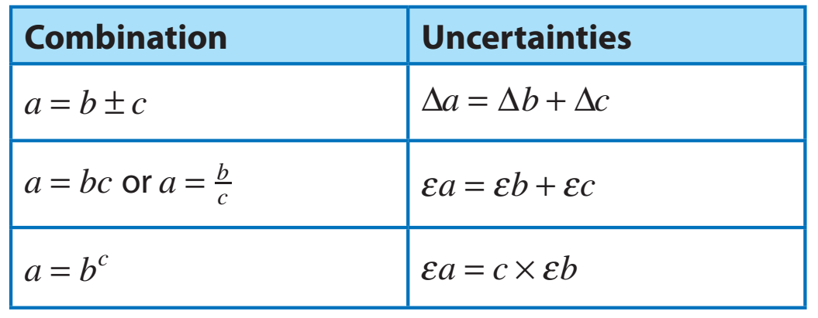
There are different rules for combining uncertainties. Remember:
Δa = absolute uncertainty
εa = percentage uncertainty
Examples:
1) Thinking distance = 100 ± 15 m
Braking distance = 200 ± 30m
Calculate the total stopping distance

Slide 5
There are different rules for combining uncertainties. Remember:
Δa = absolute uncertainty
εa = percentage uncertainty
Examples:
2) Current in a circuit is 4.2 ± 0.2 A, while the resistance of a component is 1.8 ± 0.1 Ω.
Calculate the potential difference across the component.
3) The weight of an object is 19.6 ± 0.1N. Calculate the gravitational field strength if the mass of the object is 2.0 ± 0.1 kg.
4) The radius of a circle is 15 ± 1 mm. Calculate the area of the circle.

Slide 6
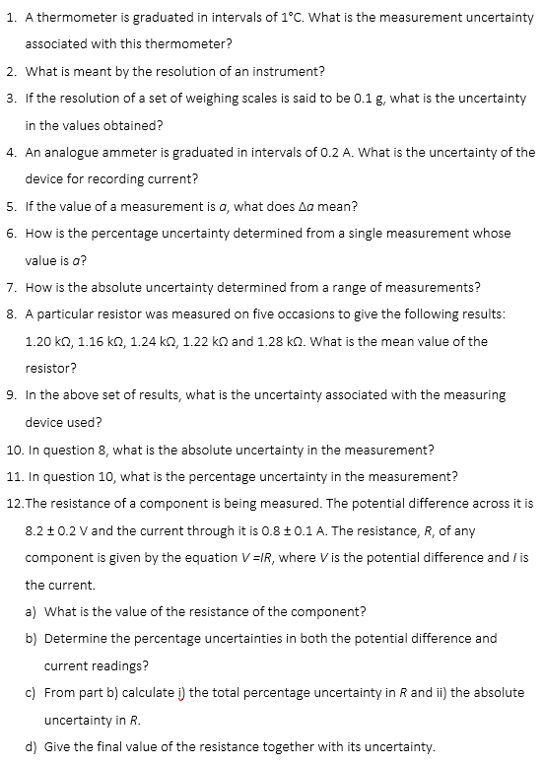
Task
Complete the task.

Slide 7

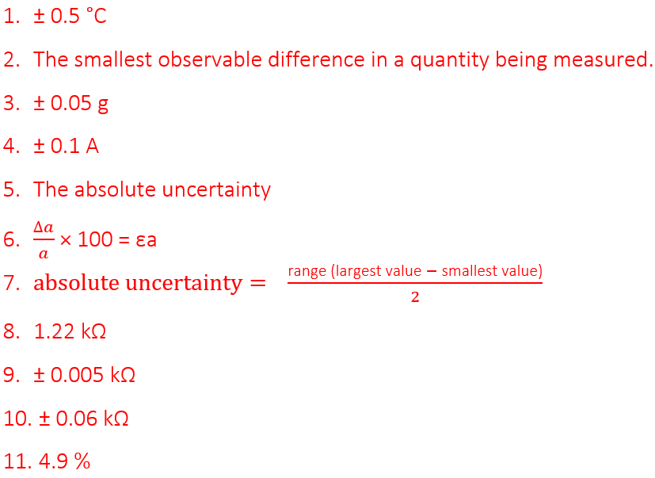
Answers

Slide 8
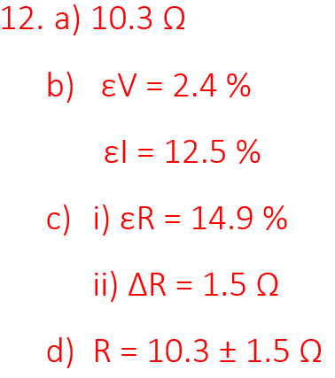
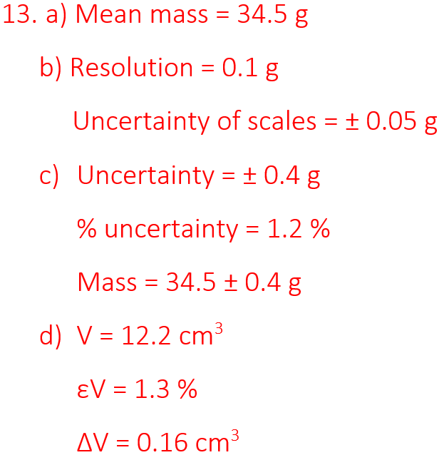
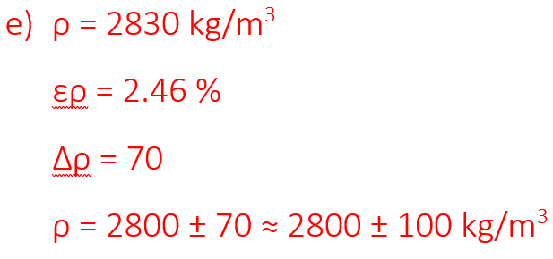
Answers

Slide 9
