Slide 1

Measurements
14/09/2022
Name four base units.
Using Newton’s second law, give the Newton in SI units.
The wavelength of green light is 532nm. Express this wavelength in terms of metres in standard form.
Convert 150 km/h to m/s.
Convert 1,500 cm² to m².
Convert 200,000 mm³ to m³.

Slide 2
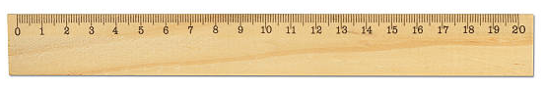
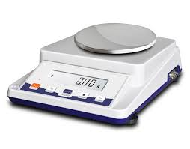
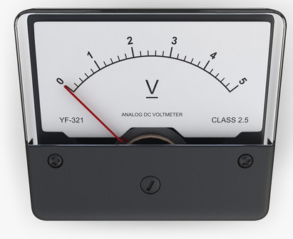
Resolution = smallest non-zero interval that can be read on a device.
Stretch: What is the resolution of the ruler, voltmeter and balance?

Slide 3
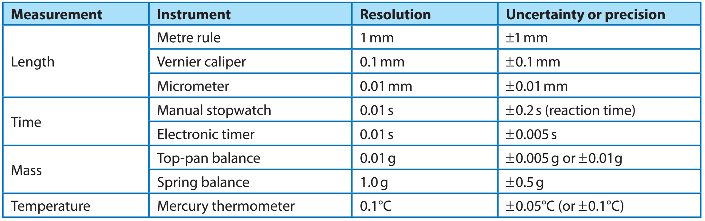
Every experimental reading you make has an uncertainty or precision. The uncertainty is no smaller than plus or minus half of the smallest division or greater.
Stretch: Why is the uncertainty of the ruler more than half the smallest division?

Slide 4
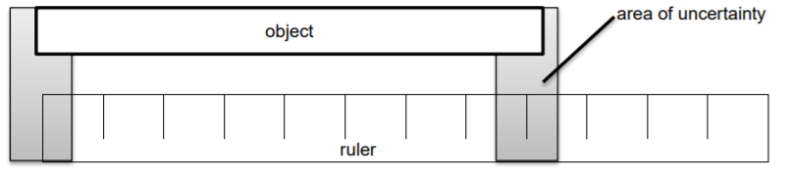
Stretch: What precautions should be taken to ensure an accurate measurement with a metre rule?
What can we use to measure very short distances?
When measuring length, two uncertainties must be included.
As both ends of the ruler have a ±0.5 mm uncertainty, the measurement will have an uncertainty of ±1 mm.

Slide 5
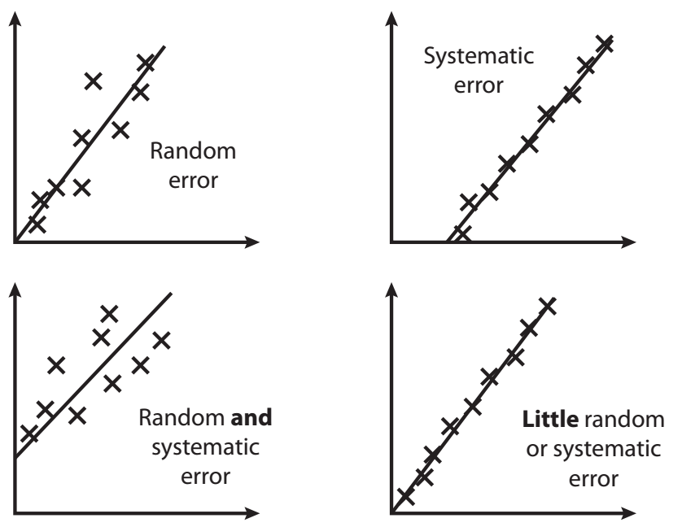
Two types of error:
Systematic (affects all measurements in same way)
Random (affects measurements in an unpredictable way).
Stretch: In the graphs, which have systematic and which have random errors?

Slide 6
The uncertainty is written to the same number of decimal places as the value and given to at most 1 or 2 sig figs.
Stretch:
A measured value of 324 is quoted with an uncertainty of 12. Write the value to 2s.f. along with the uncertainty.
A measured value of 2.335 is quoted with an uncertainty of 0.15. Write the value to an appropriate degree of accuracy along with the uncertainty.

Slide 7
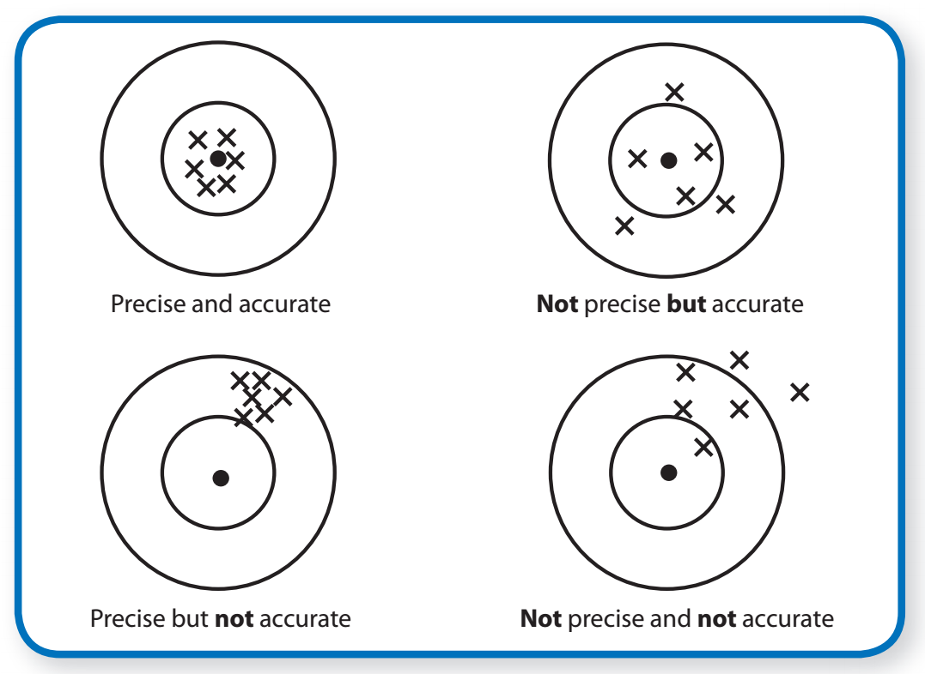
Precision – How close values are to each other
Accuracy – How close values are to “true” value.
Stretch: From the diagram, which results are precise and which are accurate?

Slide 8
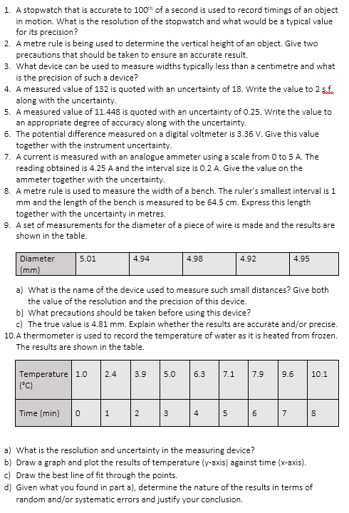
Task
Read through the notes pages in the booklet & then complete the task.

Slide 9

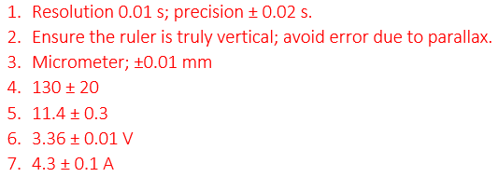
Answers

Slide 10
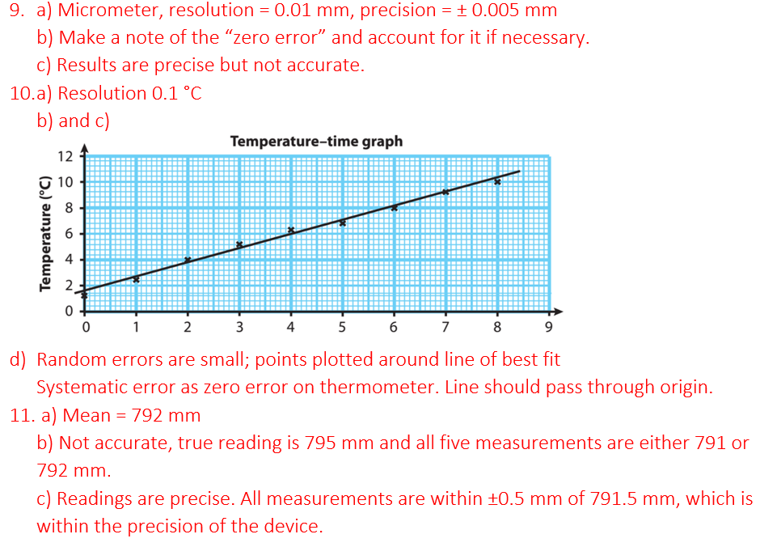
Answers

