Slide 1

Units & prefixes
14/09/2022
What are the units of:
Time b) Mass c) Current d) Force e) Distance
2. How many metres in:
1 km b) 2 mm c) 5 cm
3. How many volts in:
a) 2.5 MV b) 0.7 GV

Slide 2
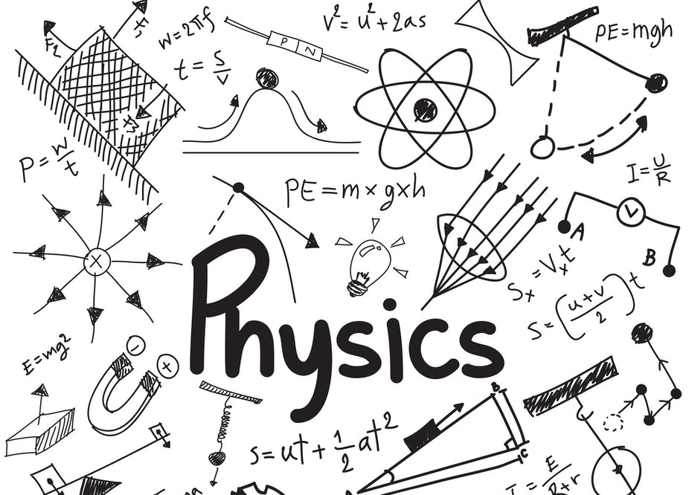
Welcome to physics!
Paper 1 Particles and radiation Waves Mechanics and materials Electricity Further mechanics (periodic motion) | Paper 2 Further mechanics (thermal physics) Fields Nuclear physics | Paper 3 Measurements and errors Option module

Slide 3
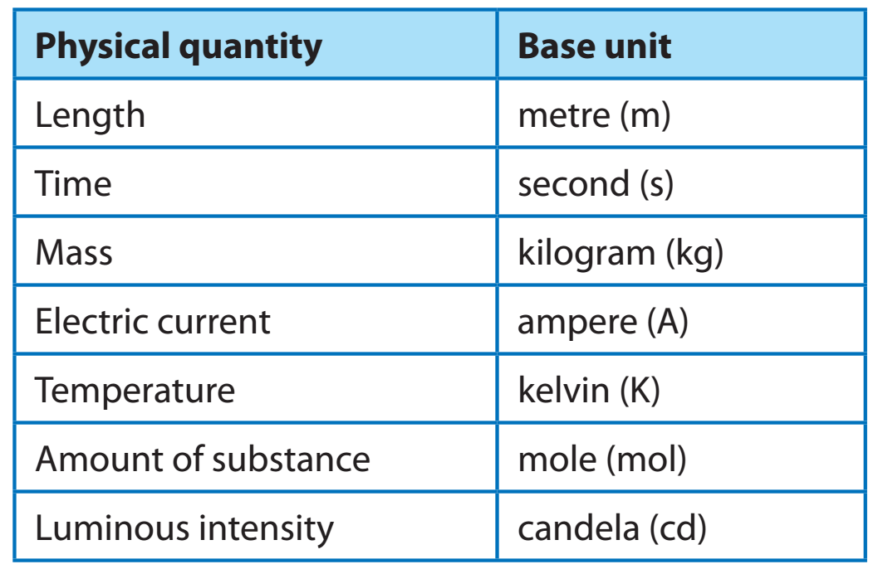
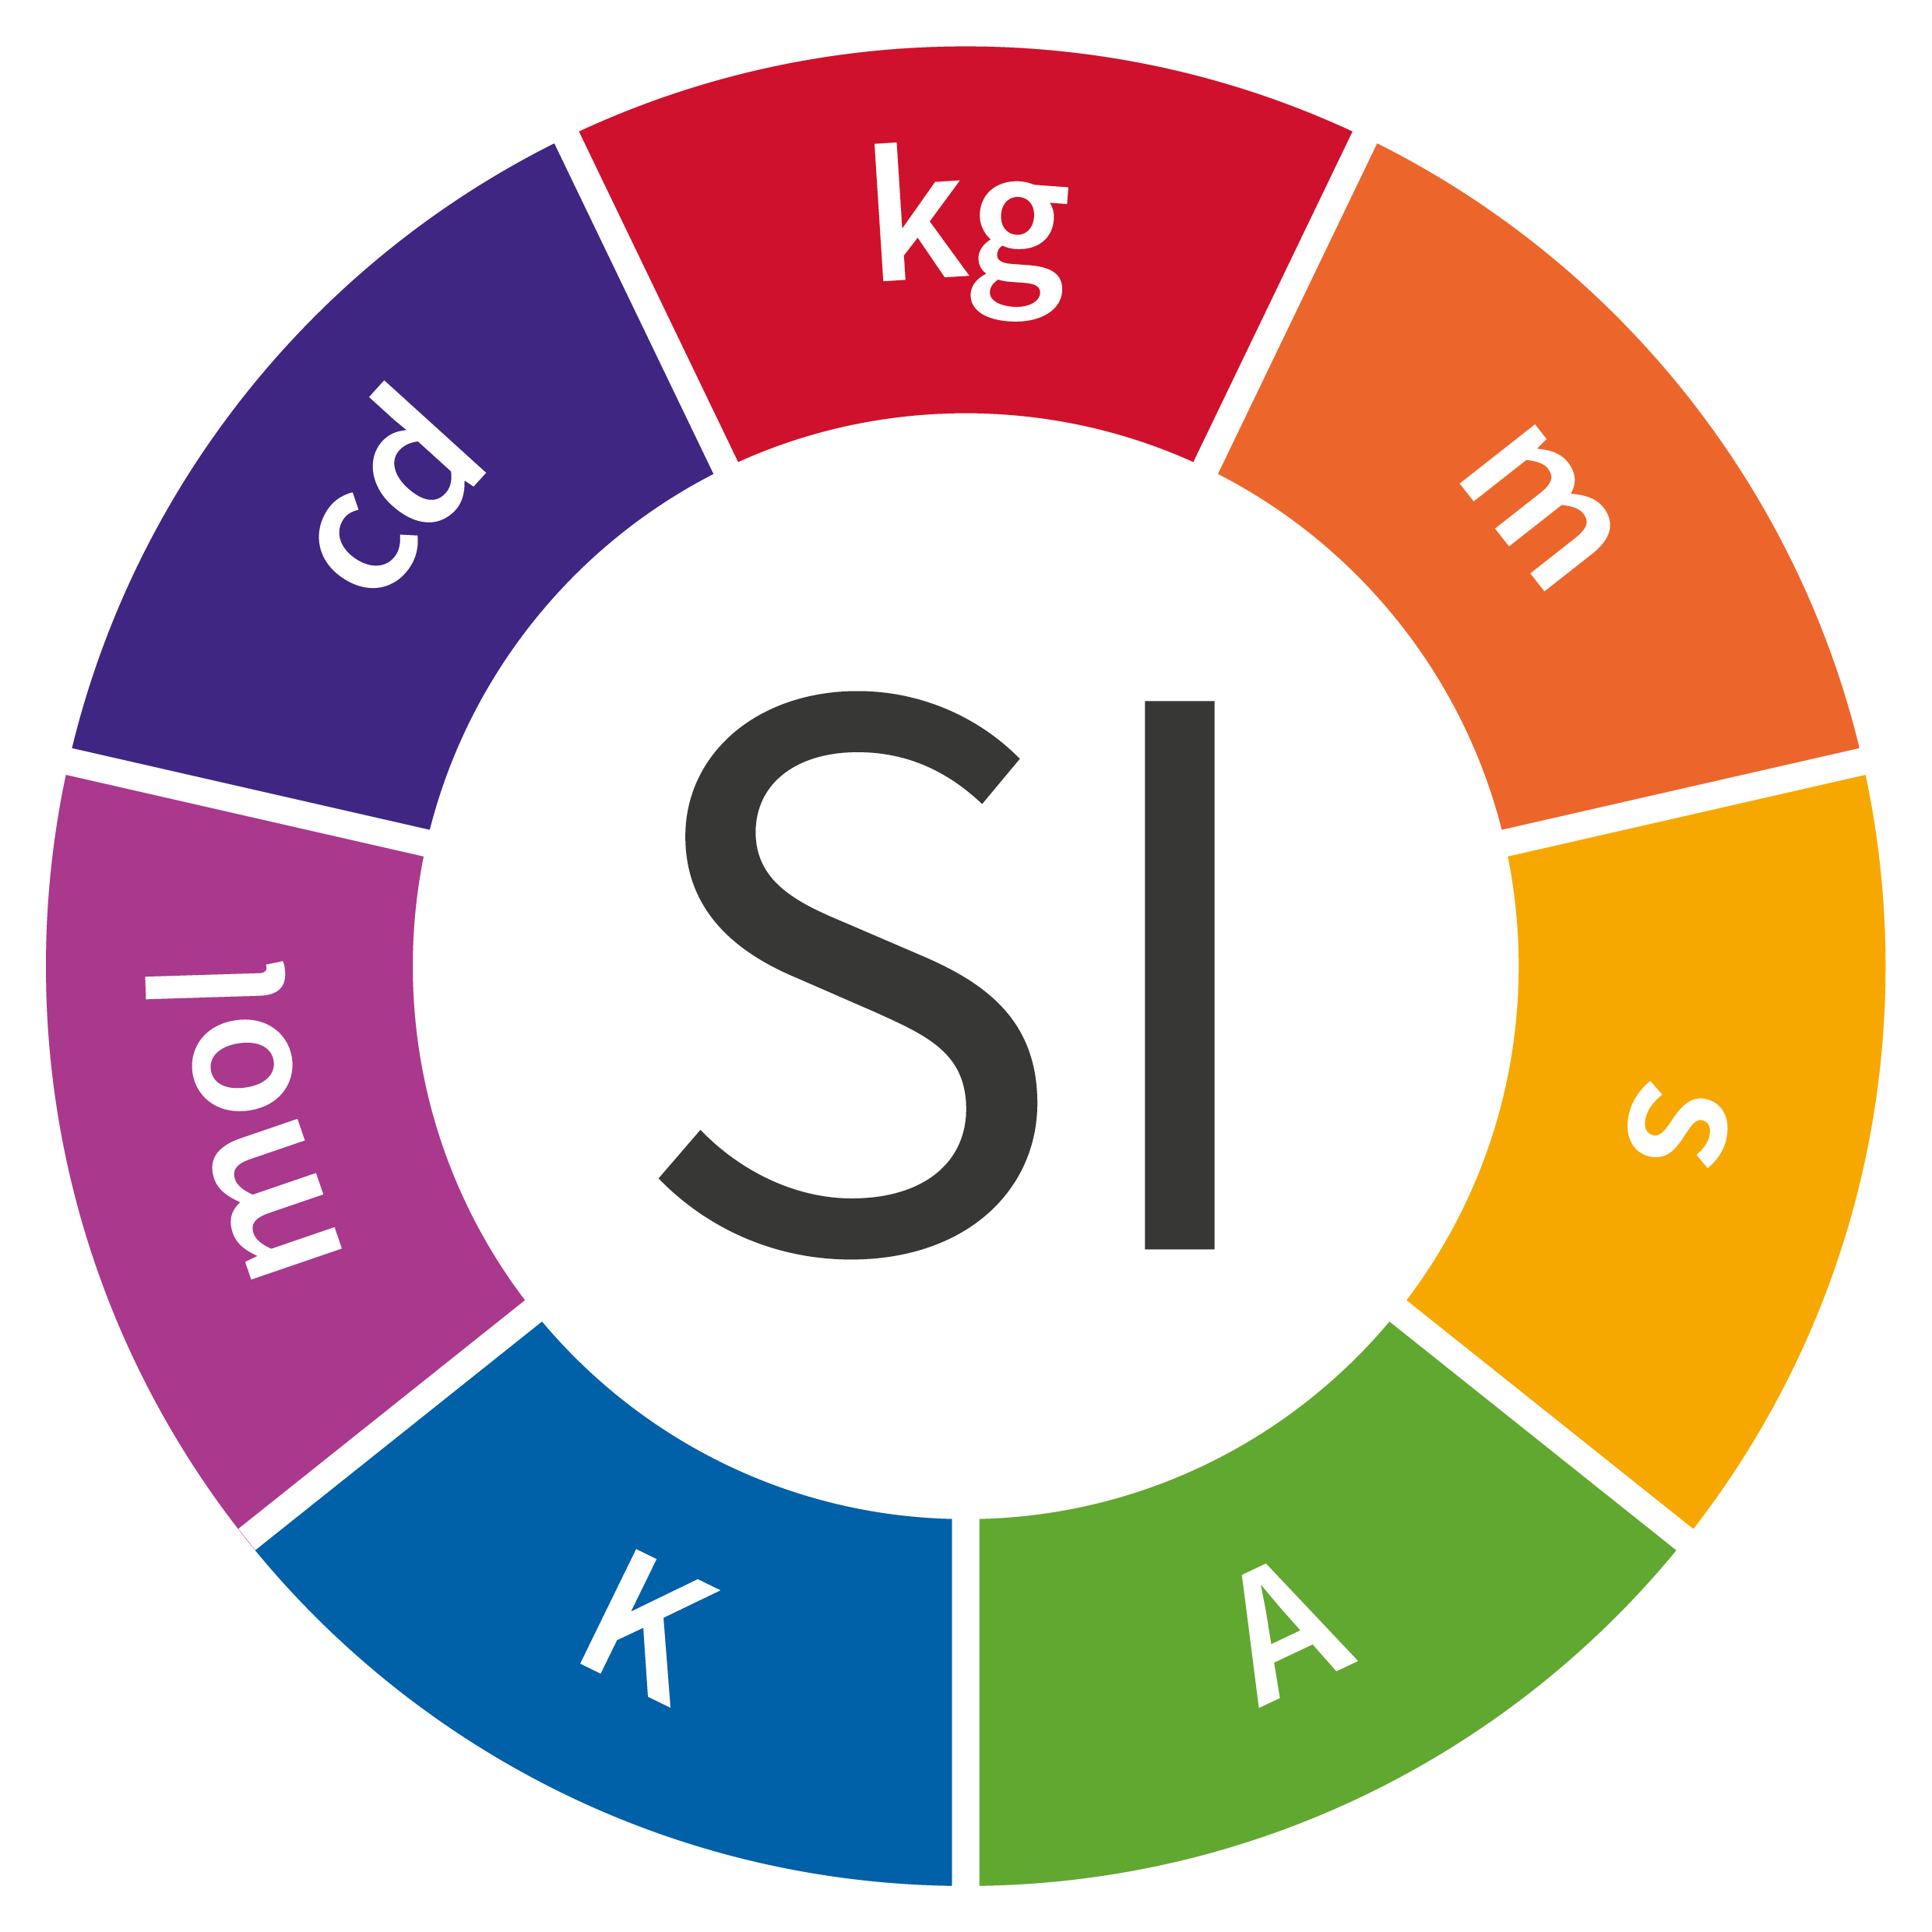
There are seven base units that all other units can be expressed in.
Stretch: What is the equation for Newton’s second law? From this equation can you express Newtons in SI units?

Slide 4
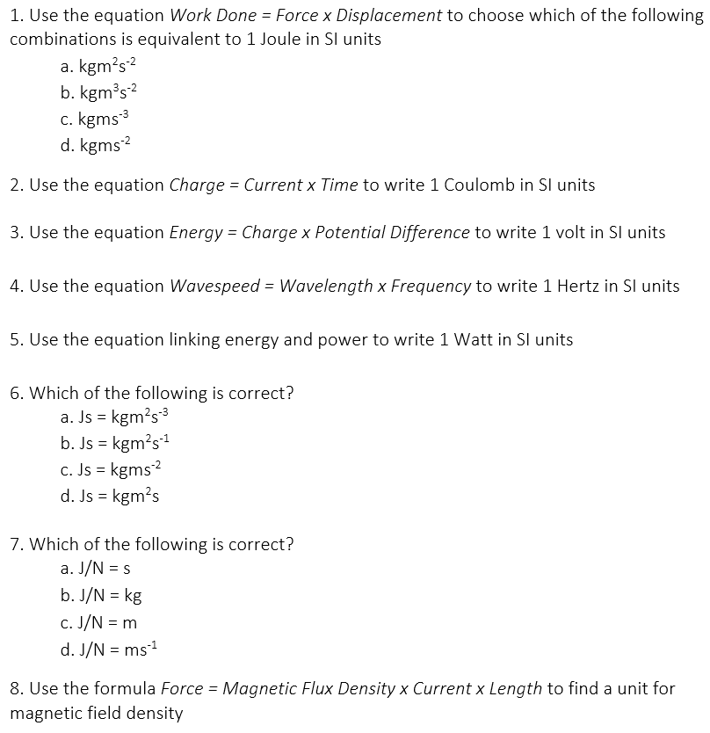
Task
Complete the task.

Slide 5
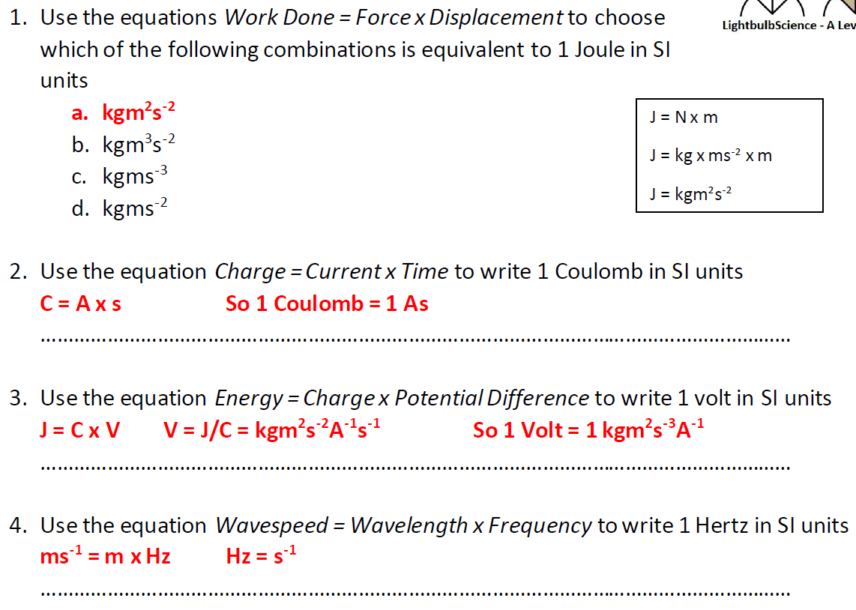


Slide 6
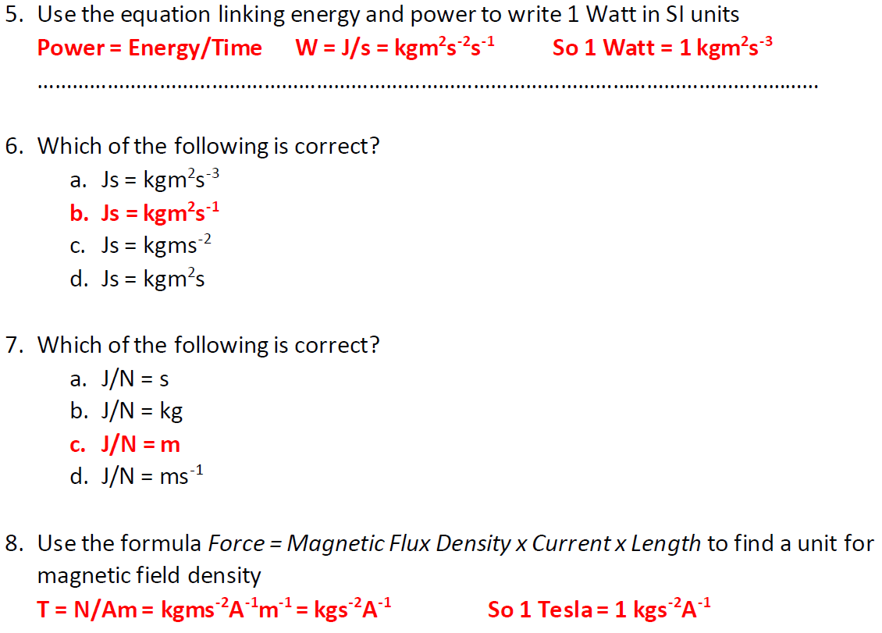

Slide 7
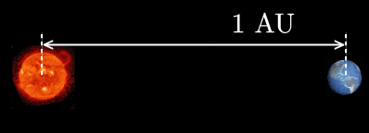
Sometimes we use non-standard like electron-volts (eV) or astronomical units (AU)
1 eV = 1.6 × 10⁻¹⁹ J
1 AU = 1.50 × 10¹¹ m
Stretch: How many Joules are there in 7 eV?
How many metres are there in 0.2 AU?

Slide 8
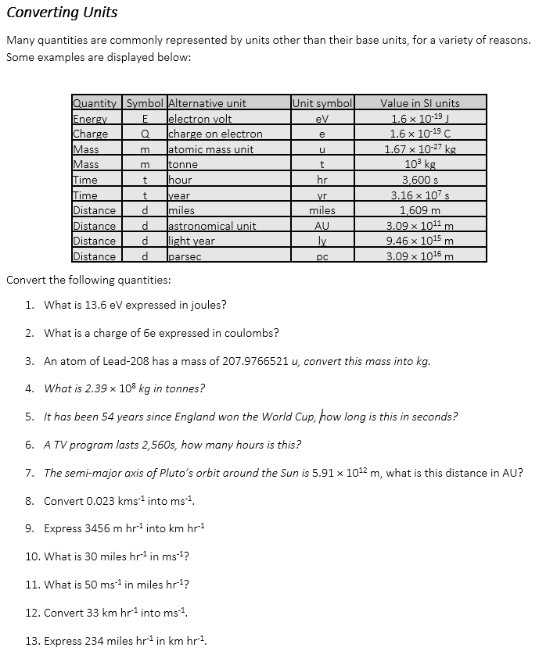
Task
Complete the task.

Slide 9
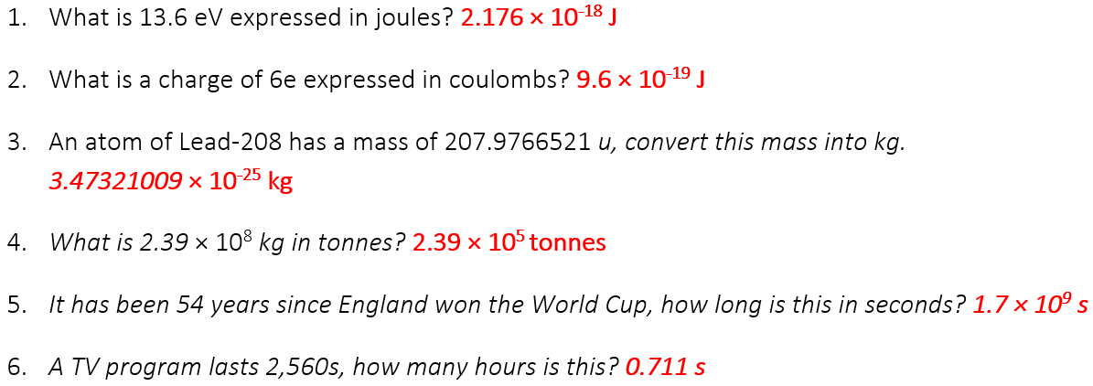
Answers

Slide 10
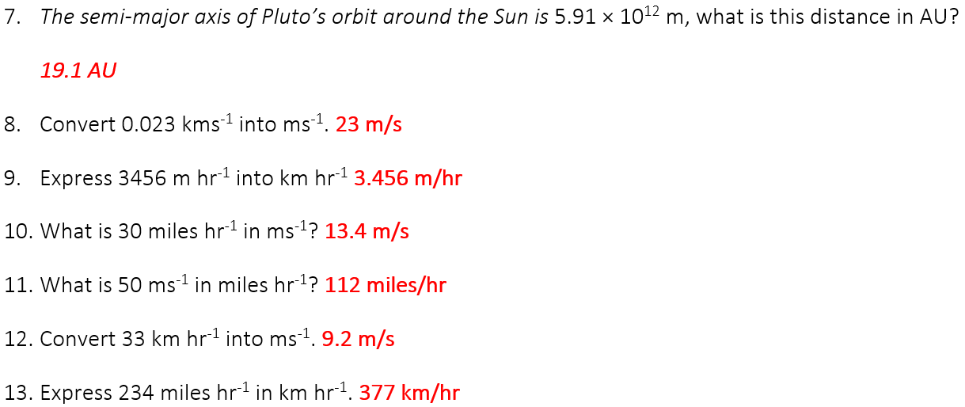
Answers

Slide 11
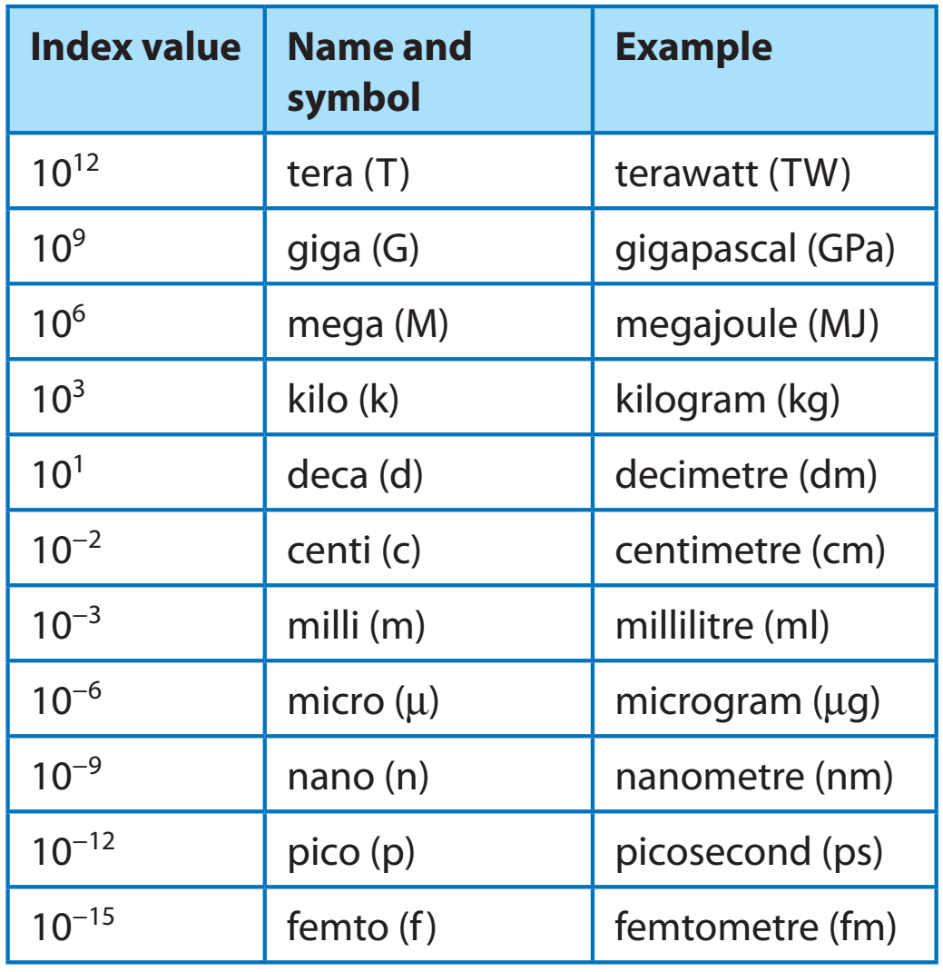
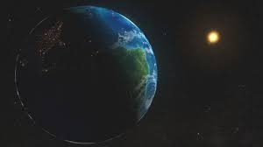
So that we don’t have to write very large or very small numbers, we use prefixes to make certain numbers easier to write.
Stretch: The distance from the Earth to the Sun is 0.15 Gigametres (Gm). How far is the Earth from the Sun in metres?

Slide 12
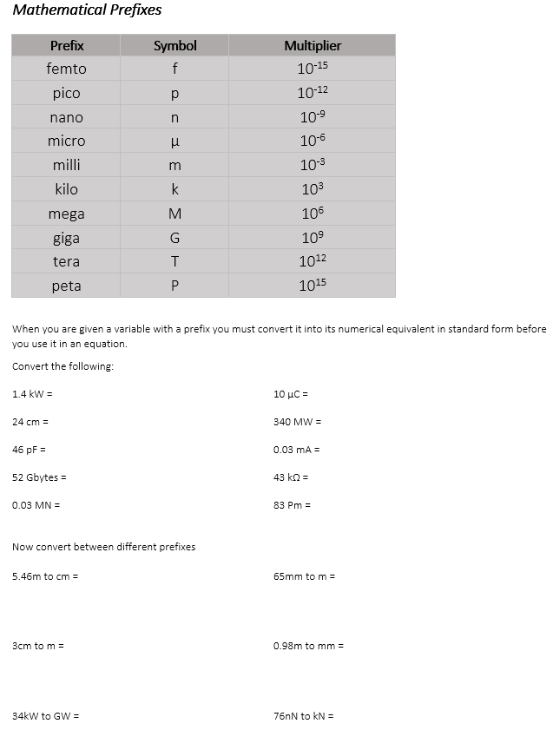
Task
Complete the task.

Slide 13
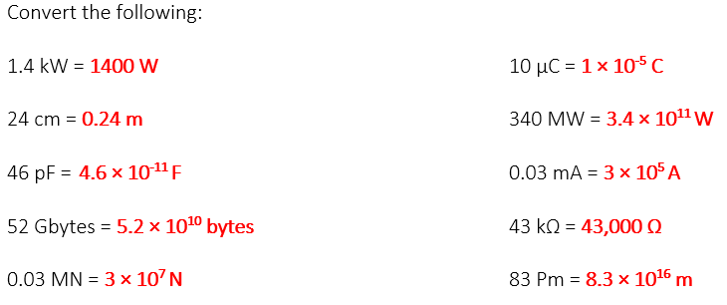

Slide 14
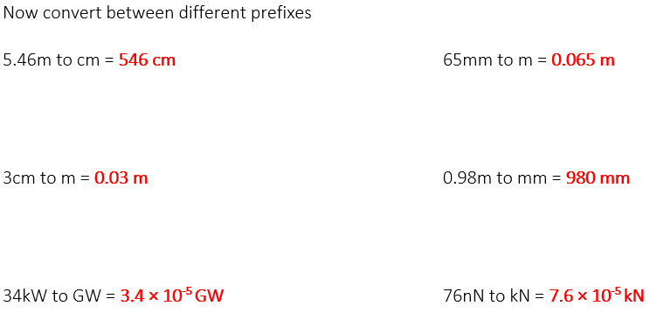

Slide 15
