Slide 1
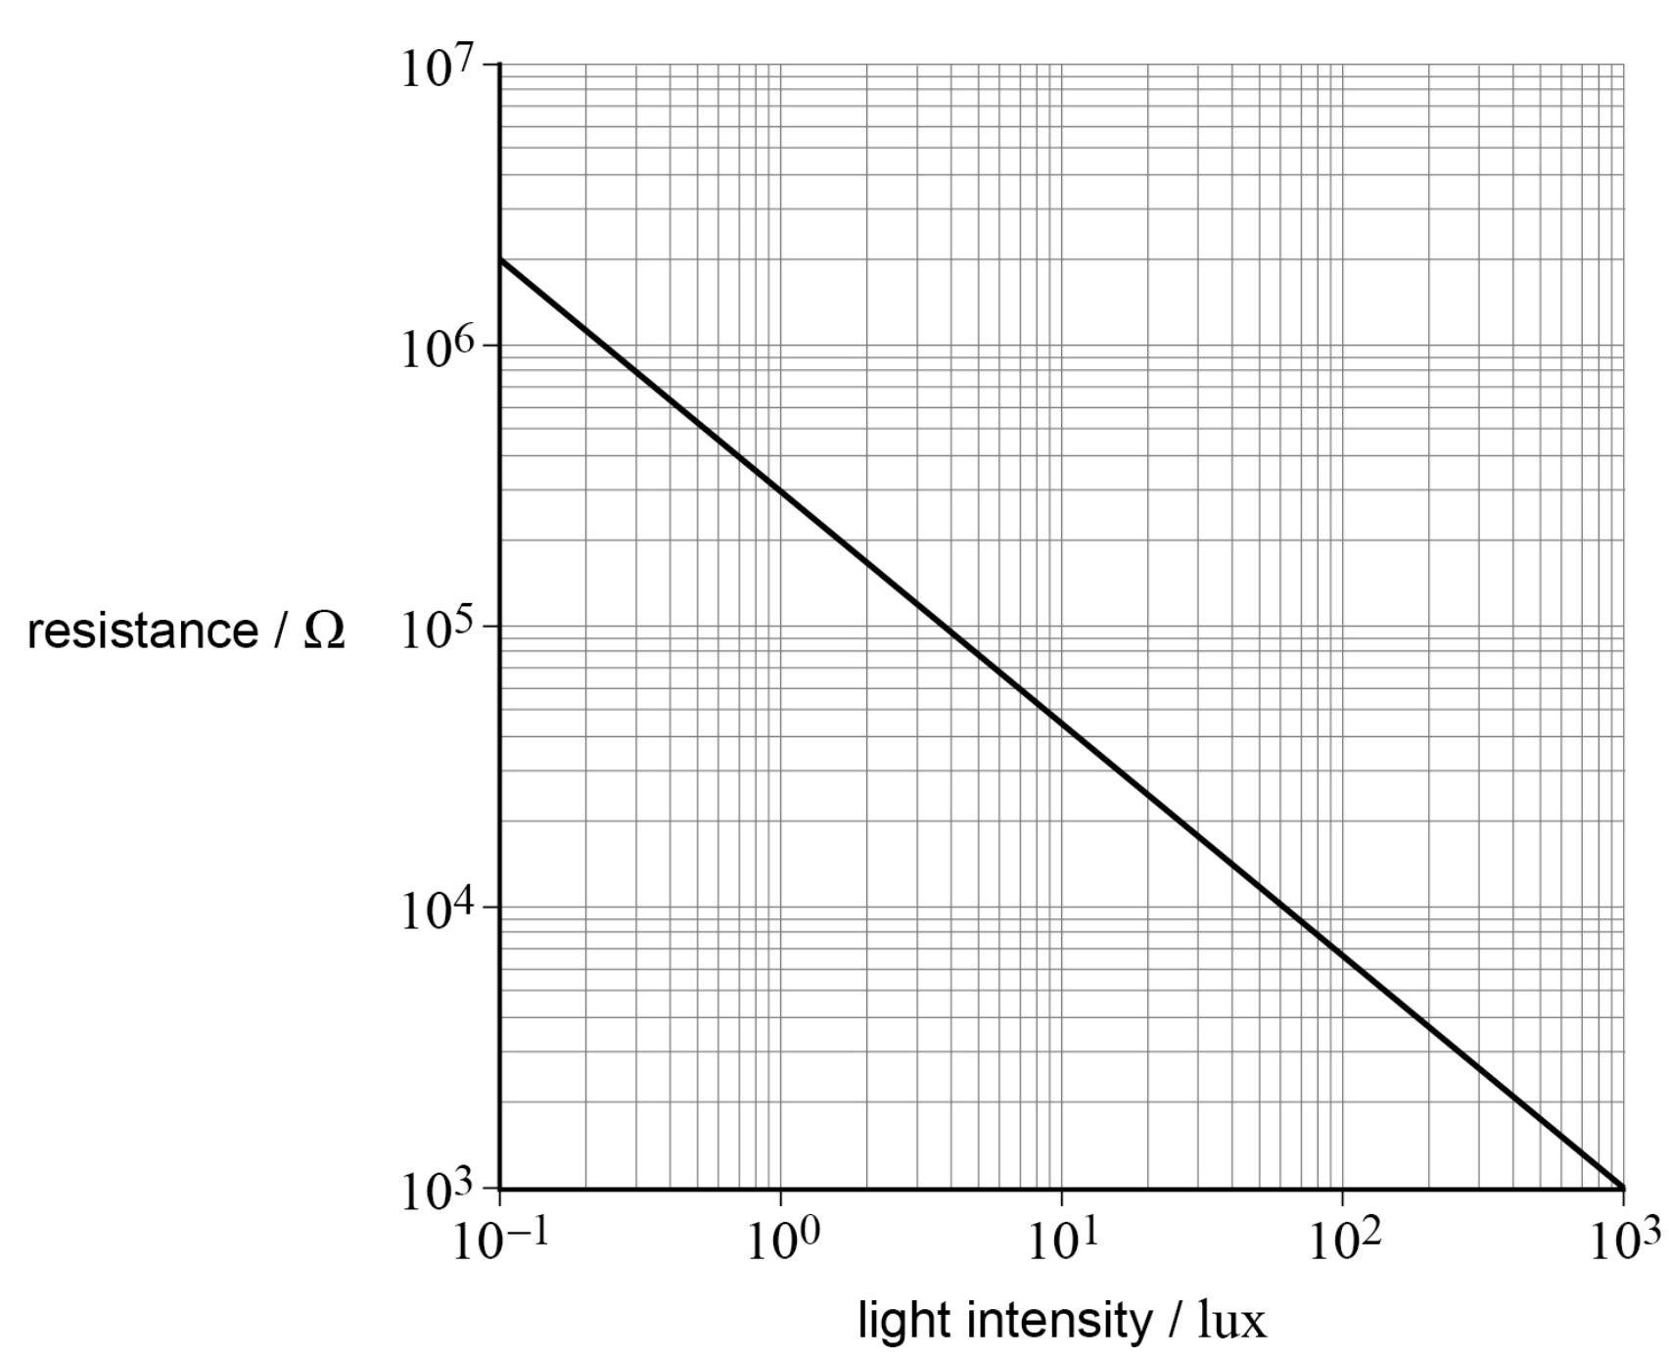
Reading log graphs:
Q1. Label the three dashed lines that are missing values for the resistance.
Q2. What is the resistance of the LDR at a light intensity of 400 lux?
Q3 What is the light intensity that causes a resistance of 400 000 Ω?
Q4 What is the resistance of the LDR at a light intensity of 1 lux?
Q5 What is the resistance of the LDR at a light intensity of 7 lux?
Q6 What is the light intensity that causes a resistance of 800 000 Ω?
1 × 10⁴
9 × 10³
8 × 10³
7 × 10³
6 × 10³
5 × 10³
4 × 10³
3 × 10³
2 × 10³
1 × 10³

